Slide 1
List and Edit Nodal Officer
NAD

Slide 2
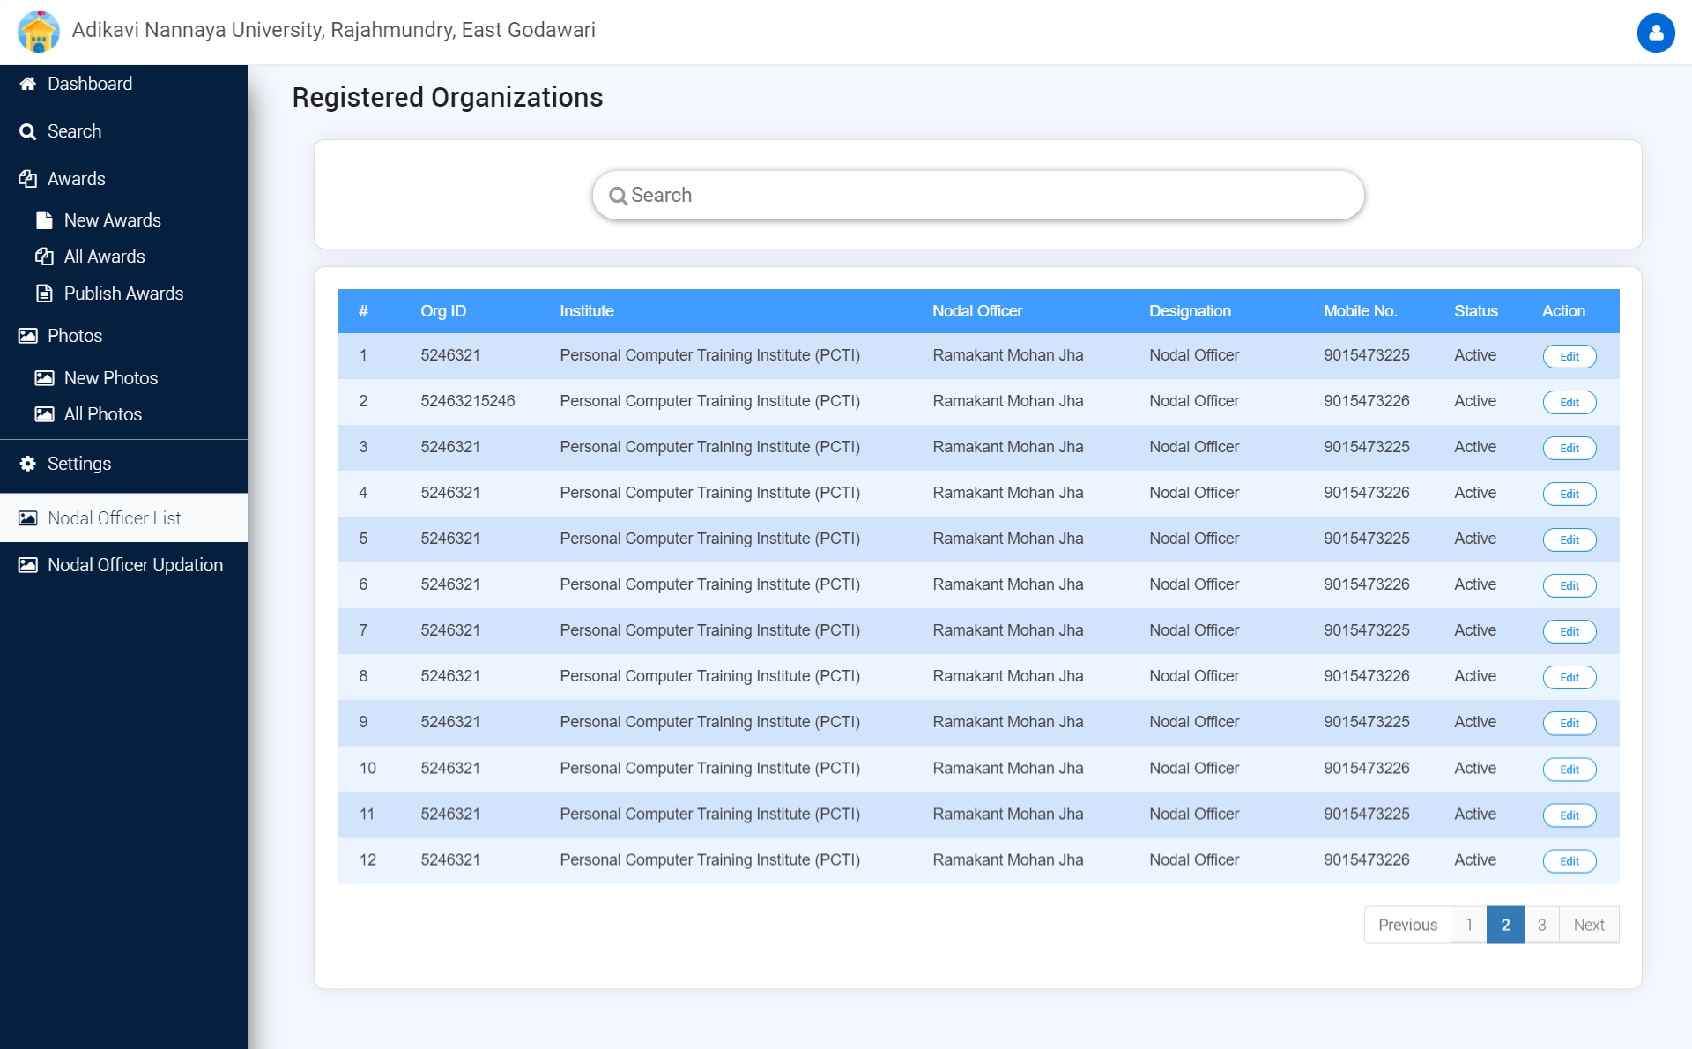

Slide 3
