Slide 1
Fuzzy Name Matching Algorithm
FuzzyWuzzy Library in Python
Presented By,
Jeevan HM
Student at Brindavan College Of Engineering

Slide 2
Index
Introduction to the Dataset
Name Cleanser 1
Double Metaphone Algorithm (Soundex)
Rules for Soundex
Metaphone a Soundex Library in Python
Testing the program
Name Cleanser 2
Removing/Changing Unicode Characters
Combining the Data-Frame
FuzzyWuzzy Library in python
Introduction to fuzzywuzzy
Levenshtein Distance
Upper and Lower Bounds
Levenshtein Distance Algorithm(Dynamic Programming)
Simple ratio Usage
Ratio for multiple names

Slide 3
Introduction to the Dataset
The dataset used is a twitter dataset that contains a Name variable set by the user. They may be of the form
An artificial name
Surname, last name (or vise versa)
Only last name
Abbreviation of Surname, Middle name or Last name.
Misspelled names etc,.

Slide 4
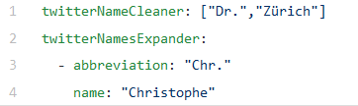
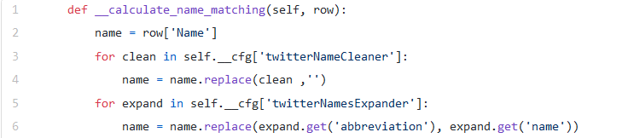
Name Cleanser 1
We create an array that has all the items we want removed from our name (Ex. Titles, symbols etc).
We then create another variable that has the acronym for all the abbreviations in the name if present.
We then go through the names in the dataset and then remove the “letters” from the name that belong in the array of items to be removed and then we expand the abbreviations is any.

Slide 5
Double Metaphone Algorithm (Soundex)
The Soundex algorithm is based on a phonetic categorization of letters of the alphabet by generating 4 Character codes. It follows a strategy of assigning a numeric value to each category. The numerical assignments are:
b, f, p, v → 1
c, g, j, k, q, s, x, z → 2
d, t → 3
l → 4
m, n → 5
r → 6

Slide 6
Rules for Soundex
Retain the first letter of the name and drop all other occurrences of a, e, i, o, u, y, h, w
Replace consonants with digits shown in the previous slide.
If two or more letters with the same number are adjacent in the original name (before step 1), only retain the first letter; also two letters with the same number separated by 'h' or 'w' are coded as a single number, whereas such letters separated by a vowel are coded twice. This rule also applies to the first letter.
If you have too few letters in your word that you can't assign three numbers, append with zeros until there are three numbers. If you have four or more numbers, retain only the first three.
Examples: "Robert" and "Rupert" return the same string "R163" while "Rubin" yields "R150". "Ashcraft" and "Ashcroft" both yield "A261". "Tymczak" yields "T522" not "T520"

Slide 7
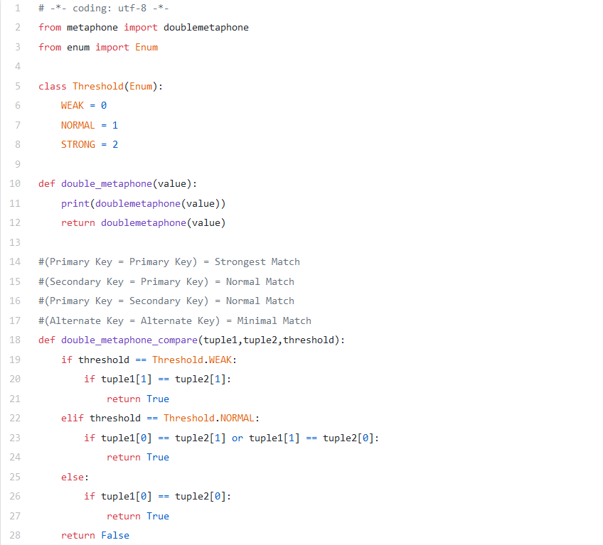
Metaphone a Soundex Library in Python
Metaphone is a library that performs the assignment of 4 digit character code of names in Python.This library instead of returning the encoded 4 digit character code it tells now “strong” the match is. It returns the threshold i.e., either 0, 1, or 2 indicating WEAK, NORMAL or STRONG respectively. We then check the the threshold and compare the 2 strings and return true and we make respective changes that led to lower results.
If none of the conditions are matched then we return false.

Slide 8
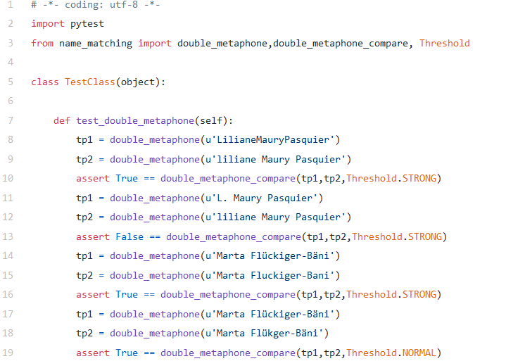
Testing the program
This part of the code is simple, we take all the functions we created above and then test the results on a few items and check if they give the same result. We do this multiple times with the same name but with a few changes like a few extra or no spaces, extra symbols etc.

Slide 9
Name Cleanser 2
Based on the results of the test program we make changes to the name. The changes may include :
Getting rid of special characters that result in failure.
Out of order components i.e., last name before first name are to be sorted in alphabetical order
We may want to get rid of unicode characters (ä,ö,ü, etc.) or we may want to convert them to their english equivalent (NFKD).

Slide 10
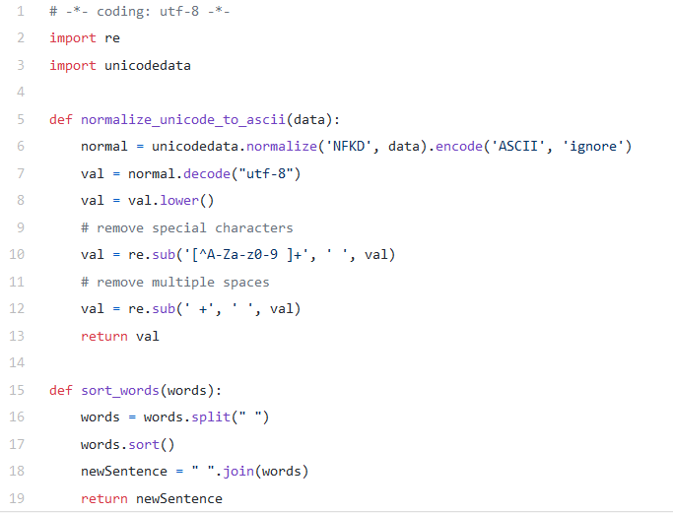
Removing/Changing Unicode Characters
We create a method that uses the unicodedata library to convert the name to ASCII and then change all character to lowercase. Afterward, two regular expressions are used to remove the special characters, as well as multiple spaces.
The regular expression term ‘[^A-Za-z0–9 ]+’ means take any number of characters between ‘A-Z’ + ‘a-z’ + ‘0–9’ +‘ ‘ out of the passed string.
After the removal of the Unicode characters we then sort the names in ascending order to avoid Out of Order Components and create a new cleaned string.

Slide 11
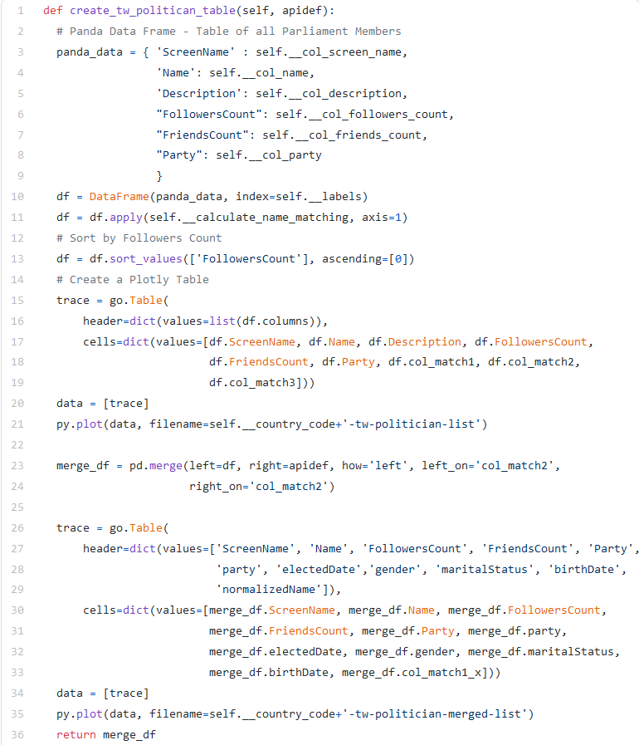
Combining the Data-Frame
Now that all the steps are done, we now combine all of them to form the Fuzzy Name Matching Algorithm. We first need to join the new data generated after cleaning to the dataset. This can be done using the panda library.
Panda make joining of datasets an easy task by using the apply method to create a new dataframe containing the 3 new datas and then the merge them with the original data frame.
We sort all the elements in the dataset based on the amount of followers.

Slide 12
FuzzyWuzzy Library in python
There are many methods of comparing string in python. Some of the main methods are:
Using regex (As discussed above)
Simple compare (Comparing 2 strings without any cleansing)
Using difflib (Using FuzzyWuzzy Library)

Slide 13
Introduction to fuzzywuzzy
This library gives us a score out of 100, that denotes two string are equal by giving similarity index.The higher the number the more similar the 2 strings are.
Fuzzy string matching is the process of finding strings that match a given pattern. Basically it uses Levenshtein Distance to calculate the differences between sequences. This library can be installed using the pip command “pip install fuzzywuzzy”.

Slide 14
Levenshtein Distance
In simple words, it is the minimum number of steps needed to change a word to the desired outcome.
For example, the Levenshtein distance between "kitten" and "sitting" is 3,since the following three edits change one into the other, and there is no way to do it with fewer than three edits:
kitten → sitten (substitution of "s" for "k")
sitten → sittin (substitution of "i" for "e")
sittin → sitting (insertion of "g" at the end).
There are only 3 possible edits that can be done i.e. Replace, Insert, Delete.

Slide 15
Upper and Lower Bounds
The Levenshtein distance has several simple upper and lower bounds. These include:
It is at least the difference of the sizes of the two strings.
It is at most the length of the longer string.
It is zero if and only if the strings are equal.

Slide 16
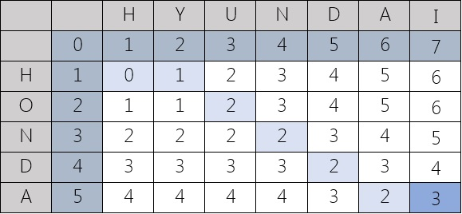
Levenshtein Distance Algorithm(Dynamic Programming)

Slide 17
Simple ratio Usage
Ratio is a built in function of the fuzzywuzzy library that calculate the Levenshtein Distance automatically and rates it on a scale of 100. Depending on the parameters needed the different keywords that calculate the Levenshtein Distance are:
fuzz.ratio(string1, string2) -> Basic Parameter and looks for exact matches
fuzz.partial_ratio(string1, string2) -> Similar to fuzz.ratio but it ignores some symbols like !.
fuzz.token_sort_ratio(string1, string2) -> This first sorts the strings to be in the same order before comparing them.
fuzz.token_set_ratio(string1, string2) -> This ignores redundant words and calculates the distance.

Slide 18
Ratio for multiple names
The process.extract(query, choices) does fuzz.ratio for all the items of the array choice by trying to convert them to the the query string.
process.extractOne(query, choice) calculates the distance of all the items but returns the top/highest one.
WRatio is another ratio most commonly used as it ignores multiple spaces, and special symbols.

Slide 19
Thank You!

