Slide 1
DigiLocker Manual
Testing
By- Neeraj Pandey

Slide 2
Content :-
Desktop Website Testing
Mobile Website Testing (ios & Android)
Mobile Application Testing (ios & Android)

Slide 3
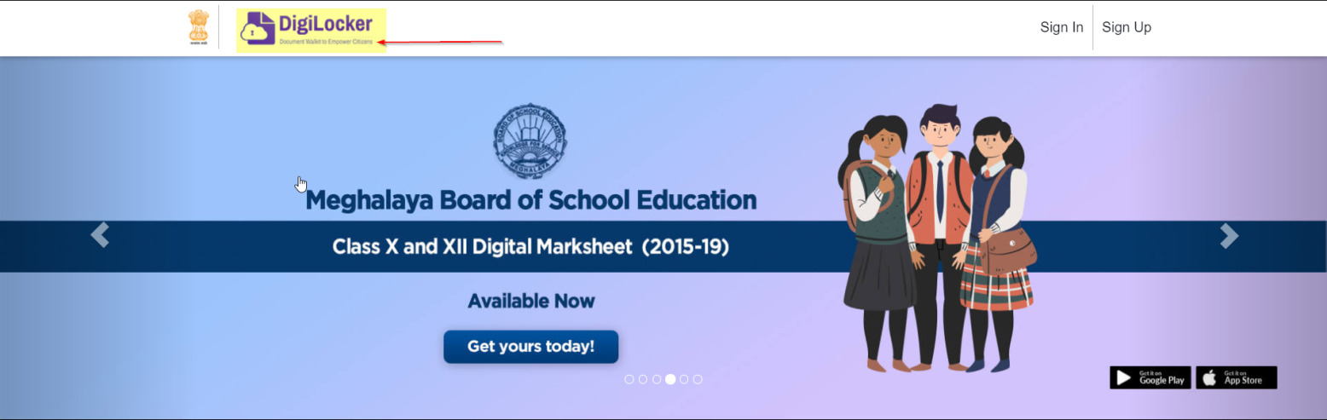
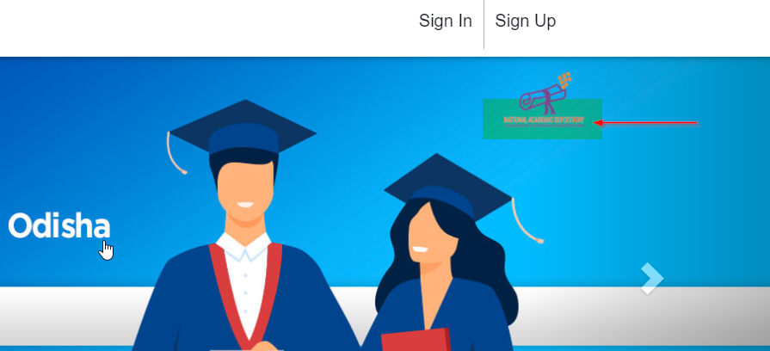
Desktop Website Testing
-> In main page marked places in below Screen-Shots is not visible clearly
https://digilocker.gov.in/
Chrome & Microsoft Edge Browser is used

Slide 4
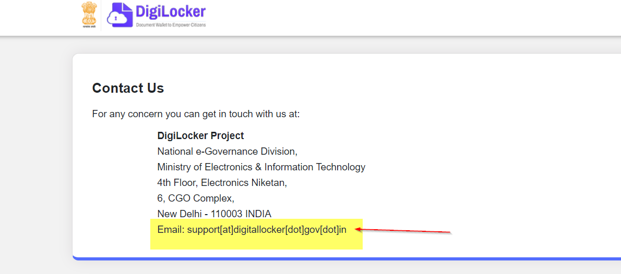
-> In contact section Email is not clear.
https://digilocker.gov.in/contactus.html
Chrome & Microsoft Edge Browser is used

Slide 5
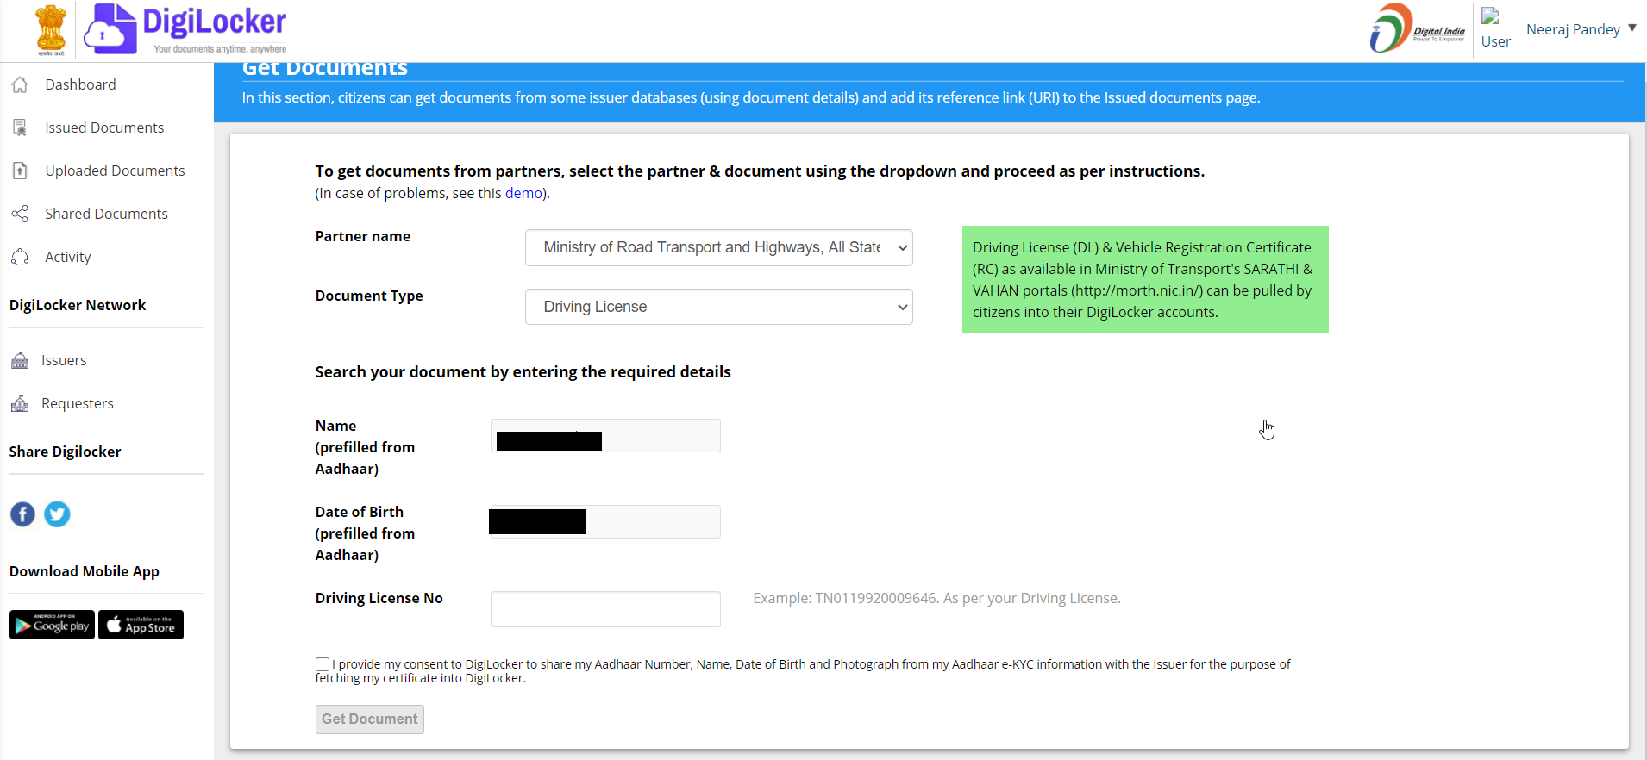
-> In get new issued documents, Once document is uploaded then also if I go to upload that same document it will ask details and upload it.
https://digilocker.gov.in/index.php/apps/partners/pull/000048/DRVLC#repositoryform

Slide 6
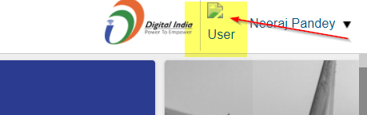
Resolved
-> On mane page right upper corner user profile photo is not visible.
https://digilocker.gov.in/index.php/apps/dashboard/#no-back

Slide 7
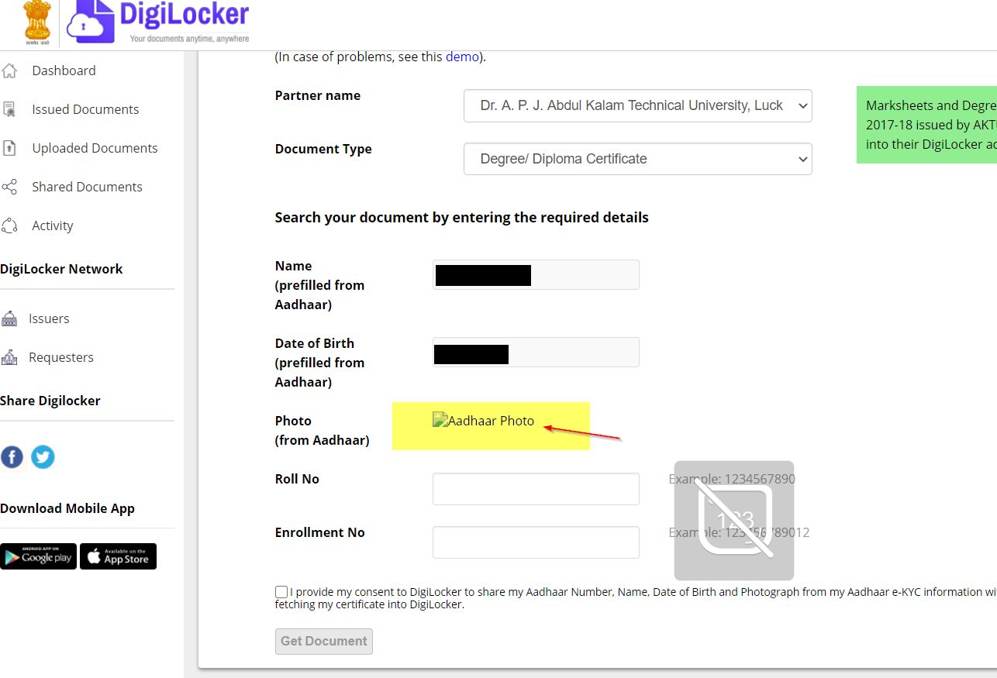
-> While uploading document in New document section Aadhar Photo is not visible.
https://digilocker.gov.in/index.php/apps/partners/pull/002030/DGCER#repositoryform

Slide 8
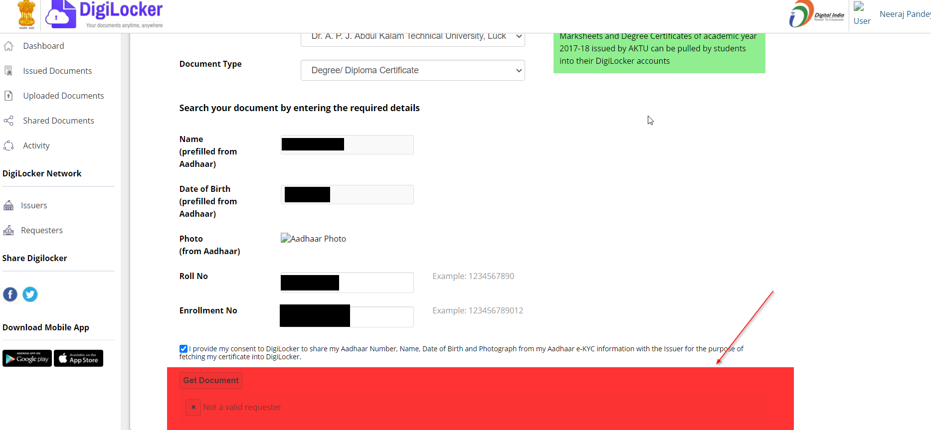
-> In new document section, Data entered is correct
Then also some times error shows while uploading new document.
https://digilocker.gov.in/index.php/apps/partners/pull/002030/DGCER#repositoryform

Slide 9
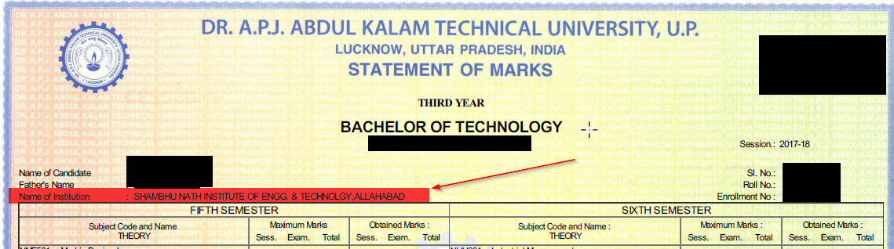
-> This can only be visible when you download Mark-sheet of this university for
this college, which is mentioned below.
In New Document section when Marksheet of Dr. A.P.J. ABDUL KALAM TECHNICAL UNIVERSITY Is downloaded this error shows :-
In Particular My Mark-sheet downloaded College Spelling is incorrect.
i.e. “Sambhu Nath Institute of Engineering Technology”-This is what written but actually it is “Sambhunath Institute of Engineering and Technology” .

Slide 10
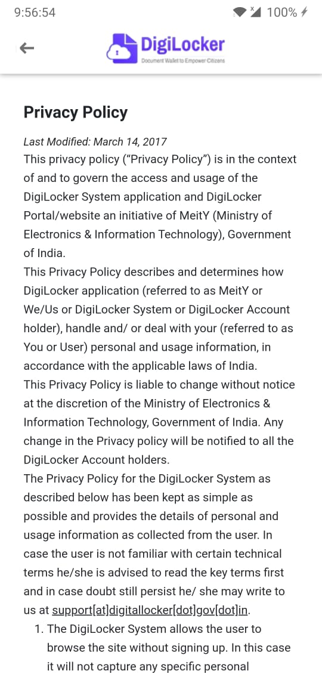
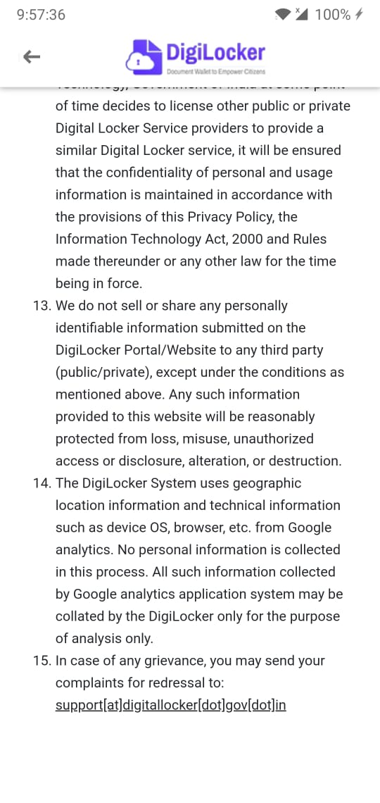
Mobile Website Testing (ios & Android)
-> In Privacy Policy, Contact us, & F&Qs Customer Support
section Email is not clear.
https://digilocker.gov.in/privacypolicy.html
https://digilocker.gov.in/contactus.html
https://digilocker.gov.in/faq.html
Chrome & Safari Browser is used

Slide 11
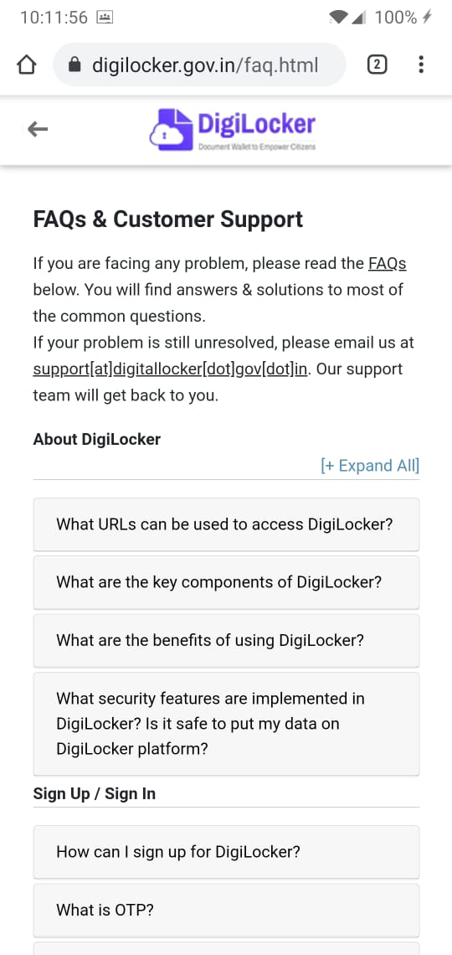
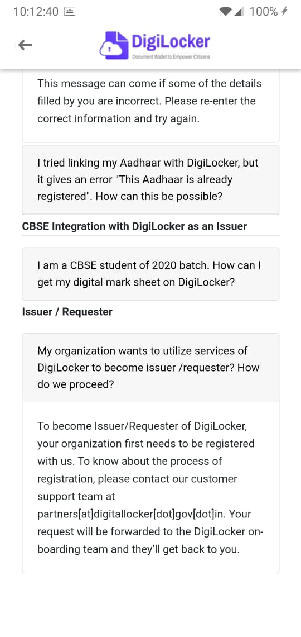
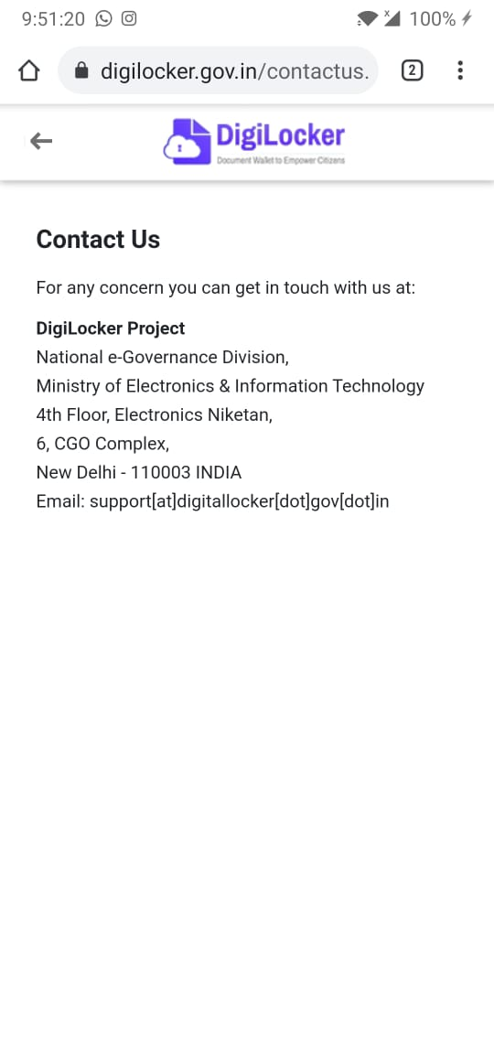

Slide 12
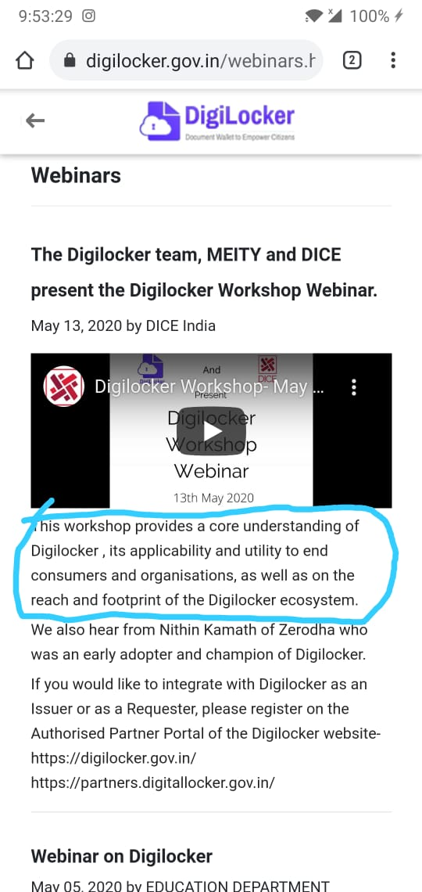
-> Kindly read the marked area in screenshot those lines are incorrect.
https://digilocker.gov.in/webinars.html
Chrome & Safari Browser is used

Slide 13
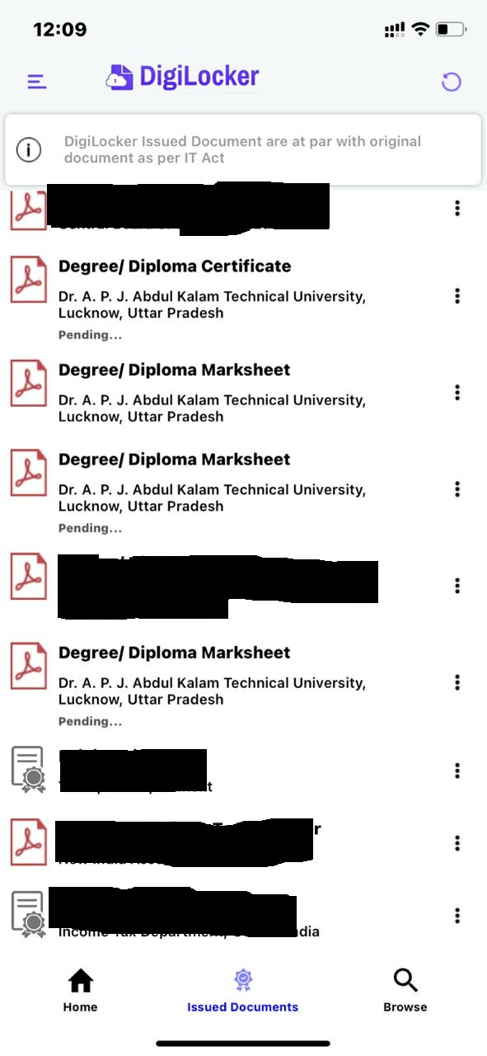
Mobile Application Testing (ios & Android)
-> In Android and Ios apps of DigiLocker, while uploading or refreshing
Documents few of the file shows pending and when clicked on download
it shows error. To resolve this issue I had to remove that document and add
it again, sometimes issue gets resolve and sometimes doesn't.
DigiLocker app is used in Iphone 11

Slide 14
Thank You

