Slide 1
REST API
Authentication Methods

Slide 2
INTRODUCTION
REST is an acronym for Representational State Transfer.
Representational state transfer is a software architectural style that defines a set of constraints to be used for creating Web services.
Web services that conform to the REST architectural style, called RESTful Web services
REST basically is a style of web architecture that governs the behavior of clients and servers.. While API is a more general set of protocols and is deployed over the software to help it interact with some other software. REST is only geared towards web applications. And mostly deals with HTTP requests and responses.
REST API’s enable you to develop and kind of web application having all possible CURD(Create, Retrieve, Update, Delete) operations. REST guidelines suggest using a specific HTTP method on a particular type of call made to the server (Technically it is possible to violate this guidelines)

Slide 3
REST API AUTHENTICATION METHODS
There are four most used Authentication Methods, they are as follows:
HTTP Authentication Schemes( Basic & Bearer)
API Keys
OAuth (2.0)
OpenID Connect

Slide 4
HTTP Authentication Schemes (Basic & Bearer) And Action
The HTTP Protocol also defines HTTP security auth schemes like:
Basic
Bearer
Digest
OAuth and others...
HTTP method for the action performed by API:
HTTPS GET
HTTPS POST
HTTPS PUT
HTTPS DELETE
HTTPS PATCH

Slide 5
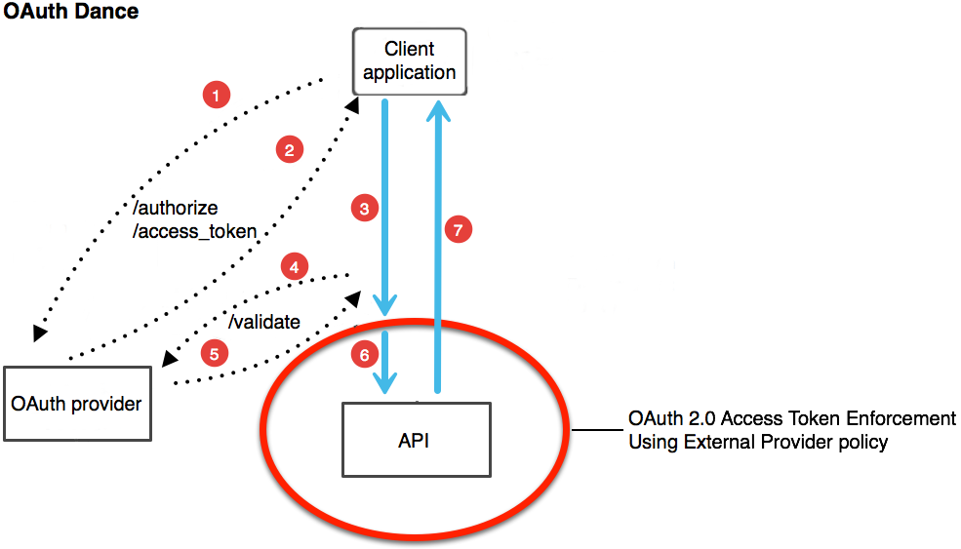
BASIC
Basic: This method is not mostly recommended due to its inherent security vulnerabilities.
With this method, the sender places a username:password into the request header. The username and password are encoded with Base64, which is an encoding technique that converts the username and password into a set of 64 characters to ensure safe transmission.
This method does not require cookies, session IDs, login pages, and other such specialty solutions, and because it uses the HTTP header itself, there’s no need to handshakes or other complex response systems.

Slide 6
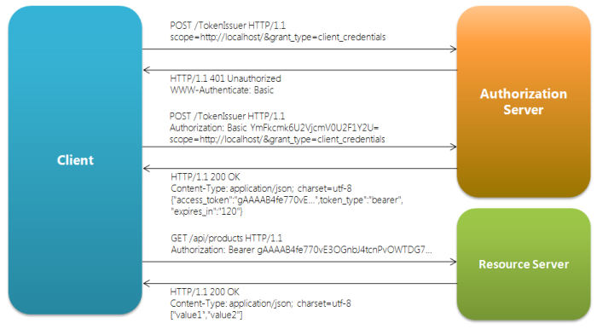
BEARER
Bearer authentication (also called token authentication) is an HTTP authentication scheme that involves security tokens called bearer tokens. The name “Bearer authentication” can be understood as “give access to the bearer of this token.” The bearer token allowing access to a certain resource or URL and most likely is a cryptic string, usually generated by the server in response to a login request.The client must send this token in the Authorization header when making requests to protected resources:
Authorization: Bearer <token>
The Bearer authentication scheme was originally created as part of OAuth 2.0 in RFC-6750 but is sometimes also used on its own.

Slide 7
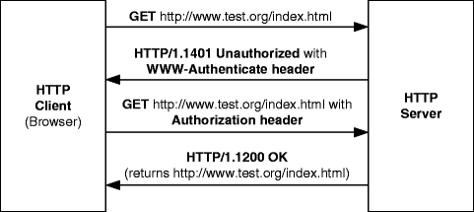
DIGEST
Digest access authentication is one of the agreed-upon methods a web server can use to negotiate credentials, such as username or password, with a user's web browser. This can be used to confirm the identity of a user before sending sensitive information, such as online banking transaction history.
Digest authentication is a method of authentication in which a request from a potential user is received by a network server and then sent to a domain controller. The domain controller sends a special key, called a digest session key, to the server that received the original request.
Digest Authentication communicates credentials in an encrypted form by applying a hash function to: the username, the password, a server supplied nonce value, the HTTP method and the requested URI. Whereas Basic Authentication uses non-encrypted base64 encoding.

Slide 8
HTTP Method for the action performed by API:
HTTPS GET
HTTPS POST
HTTPS PUT
HTTPS DELETE
HTTPS PATCH
HTTPS GET: Use GET requests to retrieve resource representation/information only – and not to modify it in any way. As GET requests do not change the state of the resource, these are said to be safe methods.
HTTPS POST: Use POST APIs to create new subordinate resources, e.g., a file is subordinate to a directory containing it or a row is subordinate to a database table. When talking strictly in terms of REST, POST methods are used to create a new resource into the collection of resources.
HTTPS PUT: Use PUT APIs primarily to update existing resource (if the resource does not exist, then API may decide to create a new resource or not).
HTTPS DELETE:As the name applies, DELETE APIs are used to delete resources (identified by the Request-URI).
HTTPS PATCH:HTTP PATCH requests are to make partial update on a resource. If you see PUT requests also modify a resource entity, so to make more clear – PATCH method is the correct choice for partially updating an existing resource, and PUT should only be used if you’re replacing a resource in its entirety.

Slide 9
API Keys

Slide 10
Intro
API Keys were created as somewhat of a fix to the early authentication issues of HTTP Basic Authentication and other such systems. In this method, a unique generated value is assigned to each first time user, signifying that the user is known. When the user attempts to re-enter the system, their unique key (sometimes generated from their hardware combination and IP data, and other times randomly generated by the server which knows them) is used to prove that they’re the same user as before.

Slide 11
API Keys Implementation
Many API keys are sent in the query string as part of the URL, which makes it easier to discover for someone who should not have access to it. Please do not put any API keys or sensitive information in query string parameters! A better option is to put the API key in the Authorization header.
Example:
Authorization: Apikey 1234567890abcdef

Slide 12
Where to find/use API Keys
Authorization Header
Basic Auth
Body Data
Custom Header
Query String

Slide 13
Features of API Keys
API Keys are simple.
The use of a single identifier is simple, and for some use cases, the best solution.
For instance, if an API is limited specifically in functionality where “read” is the only possible command, an API Key can be an adequate solution. Without the need to edit, modify, or delete, security is a lower concern.
They are secure.
They uses unique identification for every individual.

Slide 14
Disadvantages of API Keys
The problem, however, is that anyone who makes a request to a service, transmits their key and in theory, this key can be picked up just as easy as any network transmission, and if any point in the entire network is insecure, the entire network is exposed.

Slide 15
OAuth 2.0

Slide 16
Introduction
OAuth 2.0 is an authorization protocol that gives an API client limited access to user data on a web server.
More specifically, OAuth is a standard that apps can use to provide client applications with “secure delegated access” i.e handing over the authentication to another user.
OAuth 2.0 is the best choice for identifying personal user accounts and granting proper permissions.

Slide 17
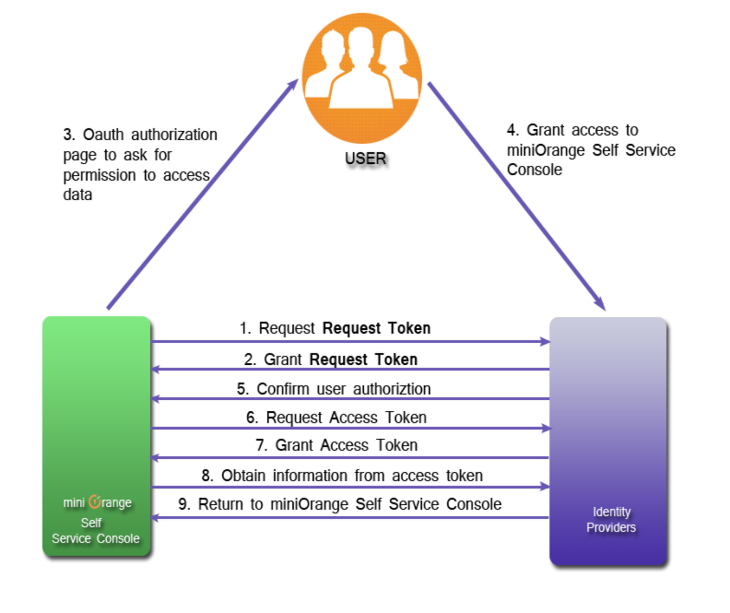
Why OAuth?
To create a better system for the web, federated identity was created for single sign-on (SSO). In this scenario, an end user talks to their identity provider, and the identity provider generates a request token which it hands off to the application to authenticate the user. The application trusts the identity provider. As long as that trust relationship works with the signed assertion, you’re good to go. The diagram below shows how this works.

Slide 18
Tokens
The most common implementations of OAuth use one or both of these tokens instead:
access token: These are sent by authorization servers like an API key, it allows the application to access a user’s data; optionally, access tokens can expire.
refresh token: These retrieve a new access token if they have expired. OAuth2 combines Authentication and Authorization to allow more sophisticated scope and validity control.

Slide 19
OAuth Actors
The actors in OAuth flows are as follows:
Resource Owner: User who owns the data in the resource server. For example, I’m the Resource Owner of my Facebook profile.
Resource Server: The API which stores data the application wants to access
Client: the application that wants to access your data
Authorization Server: The main engine of OAuth

Slide 20
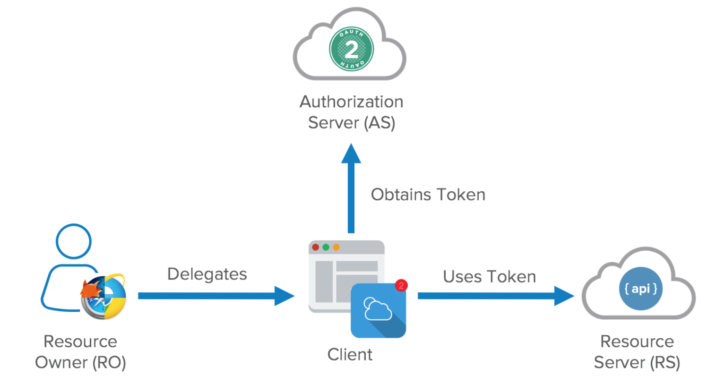
How does it work?
A client application requests authorization from User.
User authorizes Application and delivers proof.
Application presents proof of authorization to server to get access token.
This token is restricted to only access what the User authorized for the specific Application.

Slide 21
Advantages :
It allows limited access to the user's data and allows accessing when authorization tokens expire.
It has ability to share data for users without having to release personal information.
It is easier to implement and provides stronger authentication.
Disadvantages :
If your favorite sites are connected to the central hub and the central account is hacked, then it will lead to serious effects across several sites instead of just one.

Slide 22
OpenID Connect

Slide 23
Introduction
OpenID is an open standard and decentralized authentication protocol. OpenID allows you to use an existing account to sign in to multiple websites, without needing to create new passwords.
OpenID Connect is a simple identity layer on top of the OAuth 2.0 protocol, which allows computing clients to verify the identity of an end-user based on the authentication performed by an authorization server, as well as to obtain basic profile information about the end-user in an interoperable and REST-like manner.

Slide 24
Points
OpenID Connect allows a range of clients, including Web-based, mobile, and JavaScript clients, to request and receive information about authenticated sessions and end-users.
The specification suite is extensible, supporting optional features such as encryption of identity data, the discovery of OpenID Providers, and session management.
OpenID Connect defines a sign-in flow that enables a client application to authenticate a user
User identity information is encoded in a secure JSON Web Token (JWT), called ID token.

Slide 25
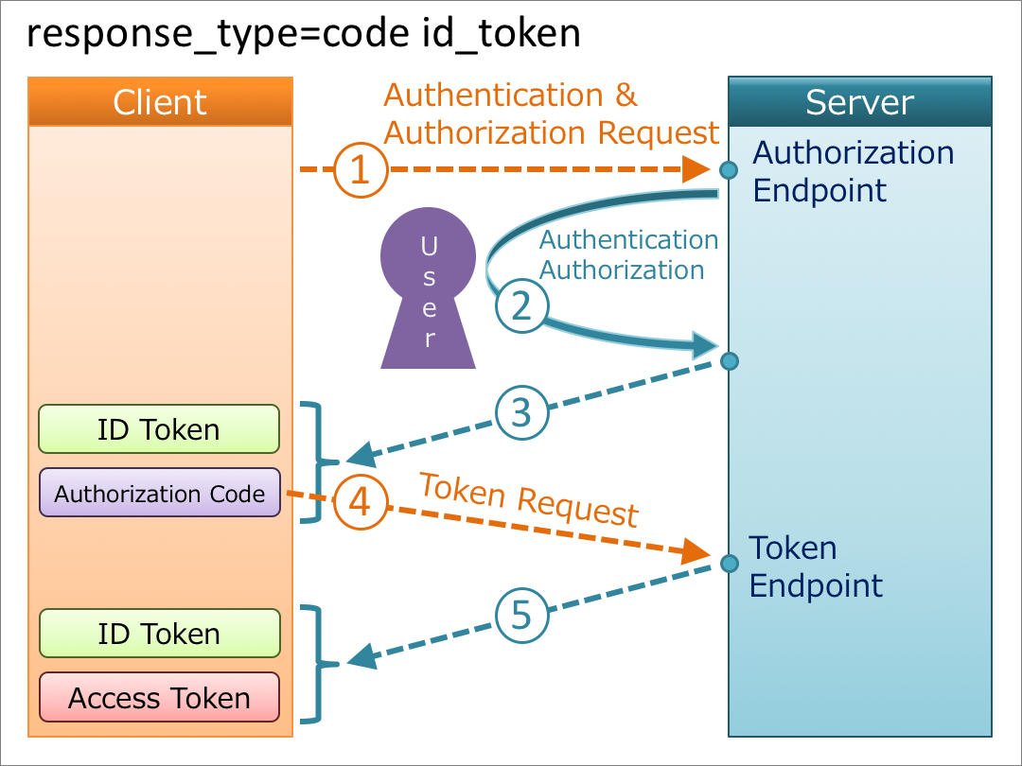
OpenID Connect Discovery
Based on the OAuth 2.0 protocol
Uses a sign-in flow that permits user authentication and information access by a client app
The user information is encoded via a secure JSON Web Token (JWT)

Slide 26
Advantages:
Accelerate Sign Up Process at Your Favorite Websites.
Reduce Frustration Associated with Maintaining Multiple Usernames and Passwords.
Minimize Password Security Risks.
Gain Greater Control Over Your Online Identity.

Slide 27
Disadvantages:
Hostile OpenID providers (spam?) authenticating their spambots etc.
Other security concerns by allowing a third party to authenticate your users

Slide 28
Final point
A one-line description of it

Slide 29
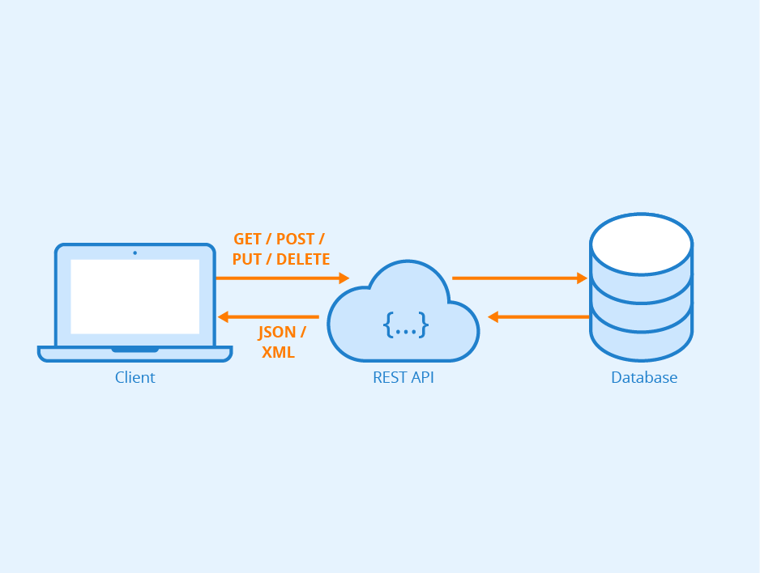
Thanks!

