Slide 1
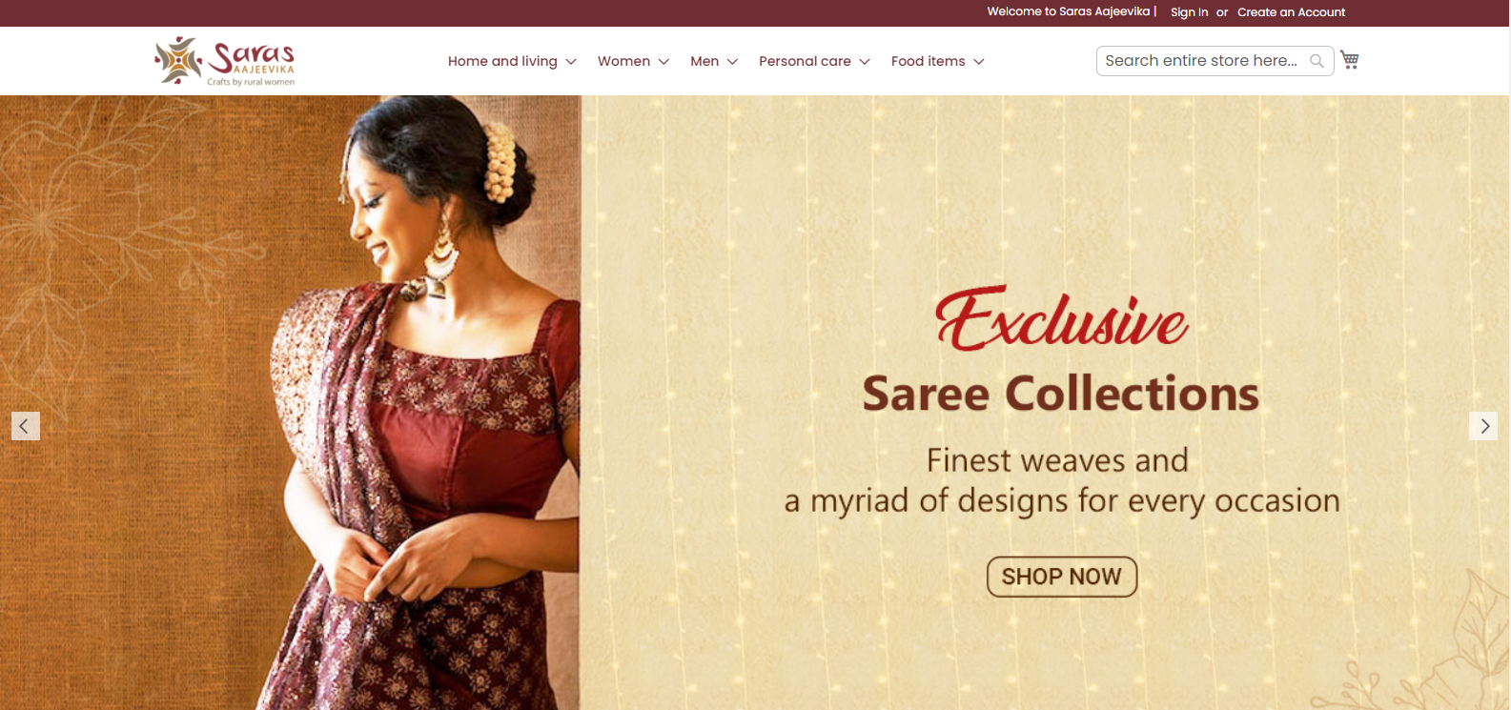
Sign In, Create Account and Profile section should be more prominent

Slide 2
The tagline is Crafts by Rural Women which generally suggests that it is something related to décor, accessories, clothes but not edibles. Food item category don’t go with the overall brand.

Slide 3
The navigation should be consistent

Slide 4
If you type a wrong spelling then it first suggests you and then you have to select the option to choose instead just auto correcting the word and searching it automatically

Slide 5
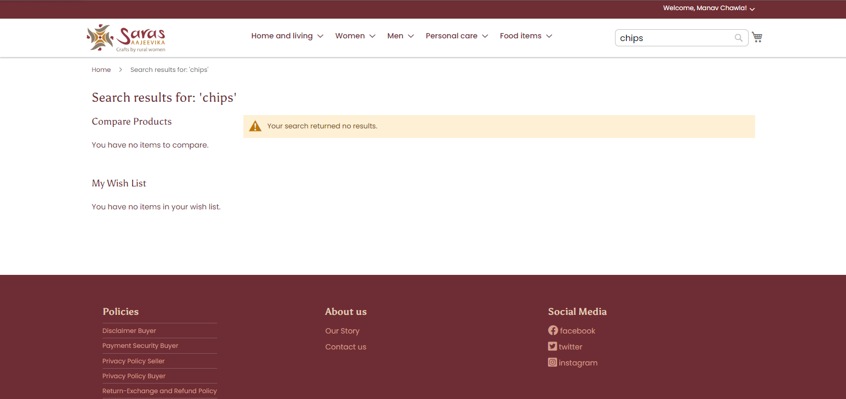
Major categories show no items in them

Slide 6
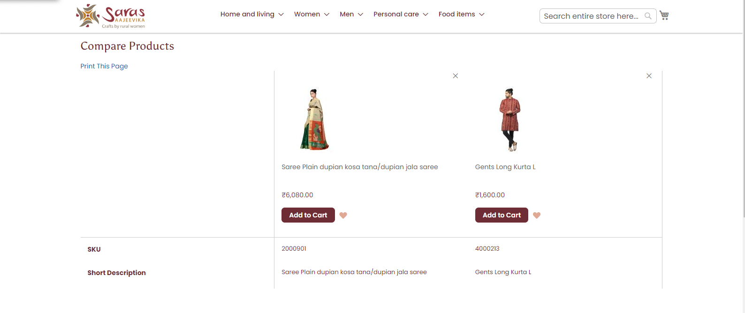
To reach to the compare screen there are bunch of slow steps which will irritate the user and there is very less info about the products on the compare screen
The compare button is should be more prominent.

Slide 7
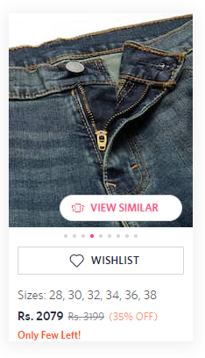
We can add view similar button near the products which will be easier for the user to explore more products

Slide 8
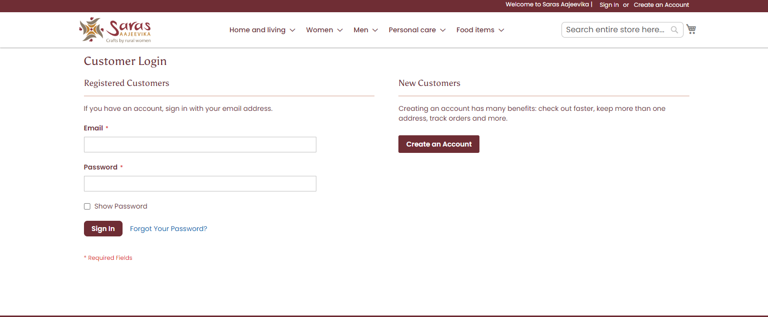
No Sign In and Create Account using Google, Meri Pehchan or other social accounts buttons.

Slide 9
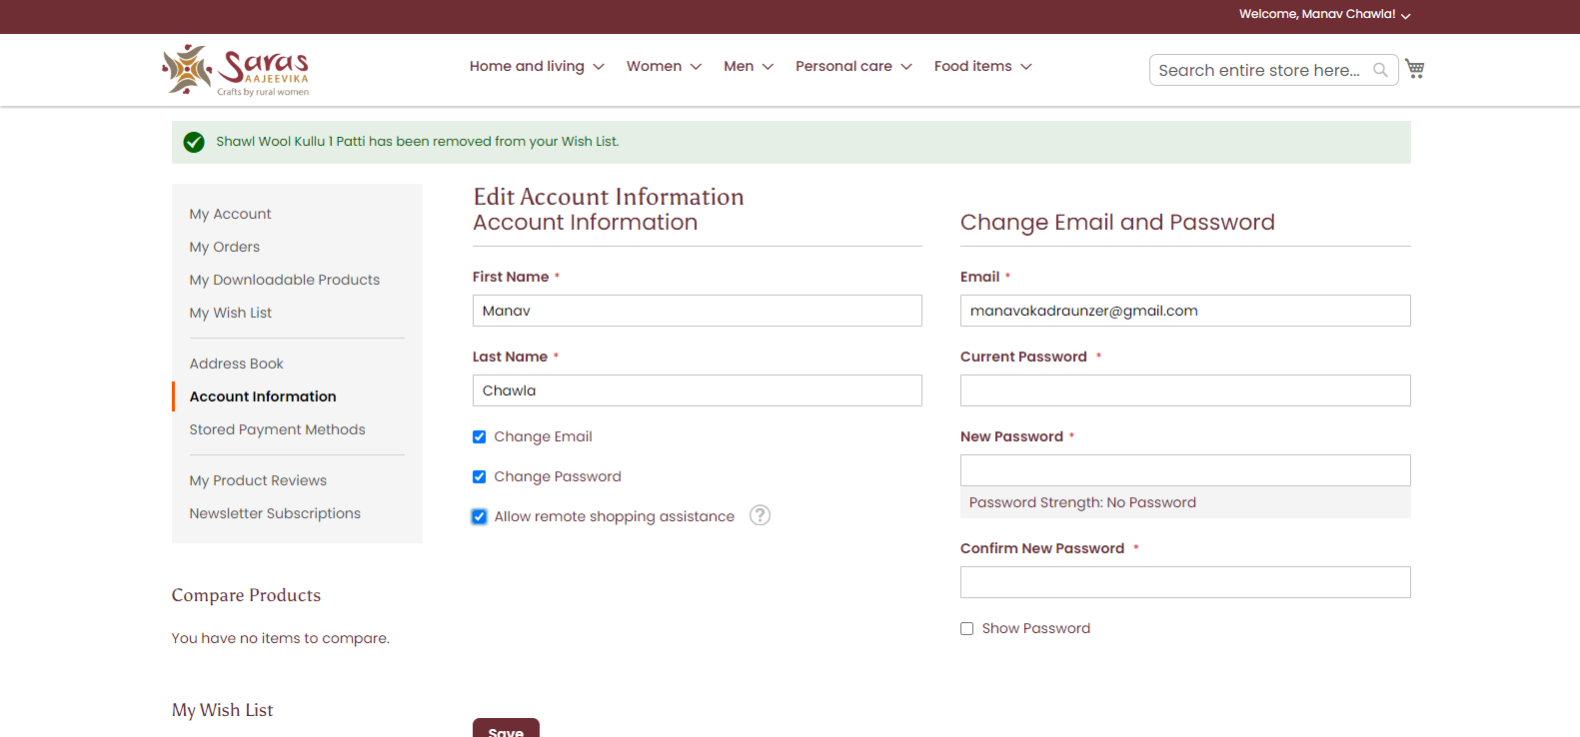
Change Email and Password should be in seperately settings tabs which can include address book and other settings

Slide 10
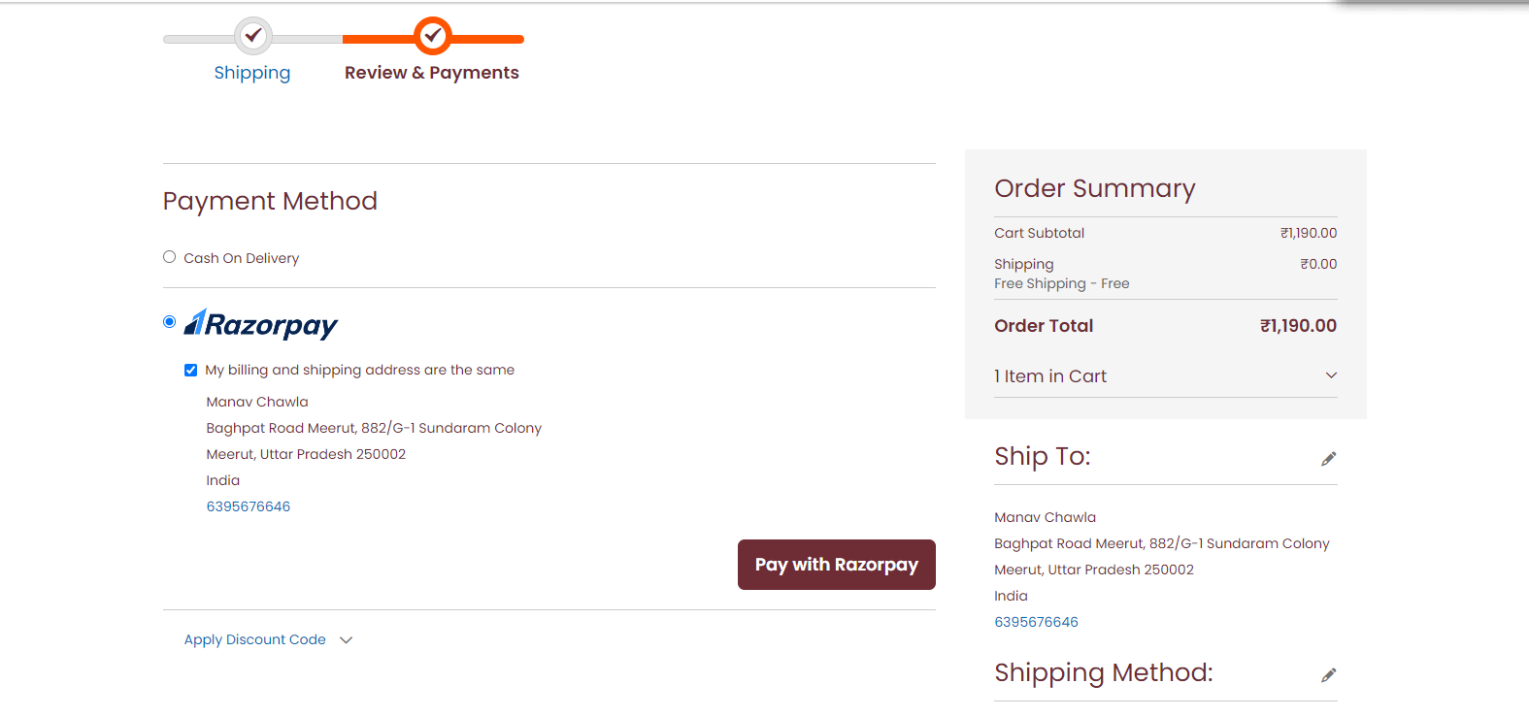
COD, Cards and UPI should be displayed.
The discount code should be displayed with order summary.

Slide 11
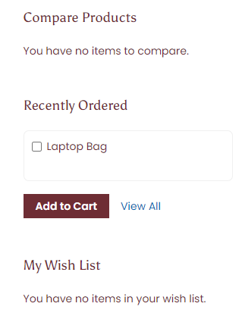
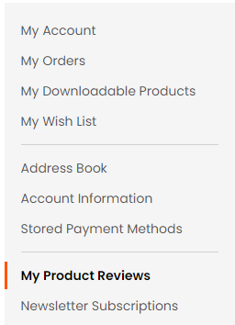
These are not needed.​

Slide 12
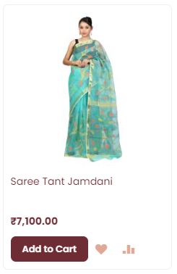
Buy Now button should be added.

