Slide 1
DIGILOCKER
TEST APP 29 BUGS
Version- TEST29.6.3.2
Updated on- 30/Nov/2020
By- Neeraj Pandey

Slide 2
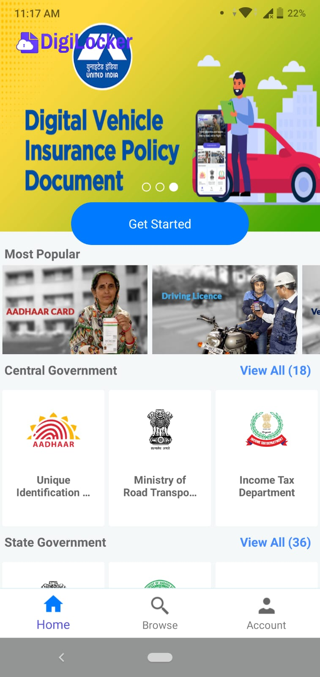
Overlapping of DigiLocker logo on Cover Add

Slide 3
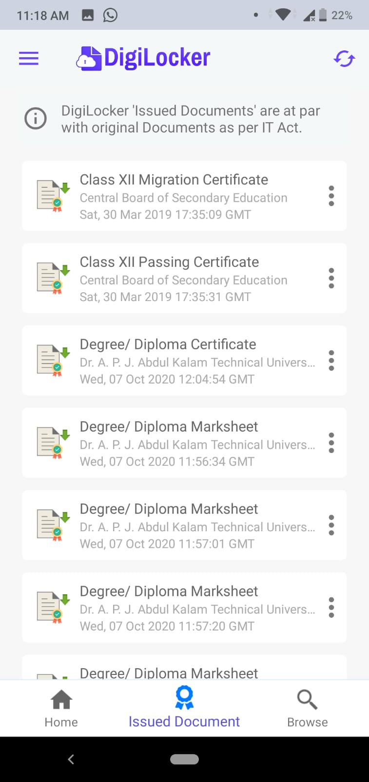
Unable to open few of my Documents like Degree/Diploma
Marksheet.

Slide 4
Search Functionality

Slide 5
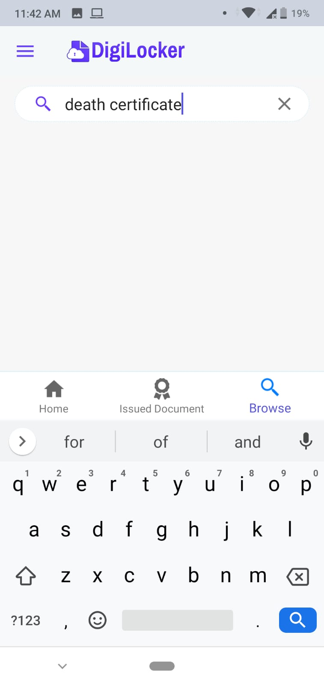
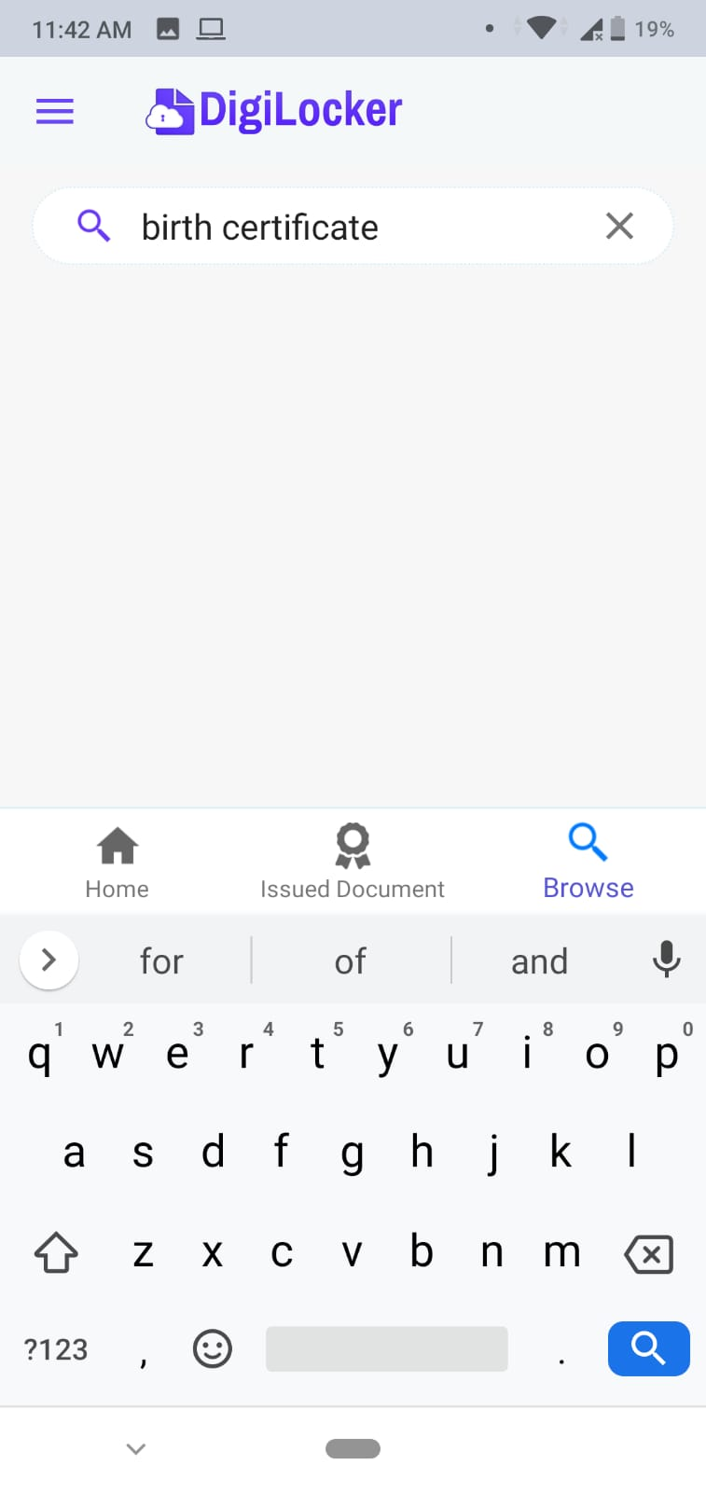
Some data is not visible while searching.

Slide 6
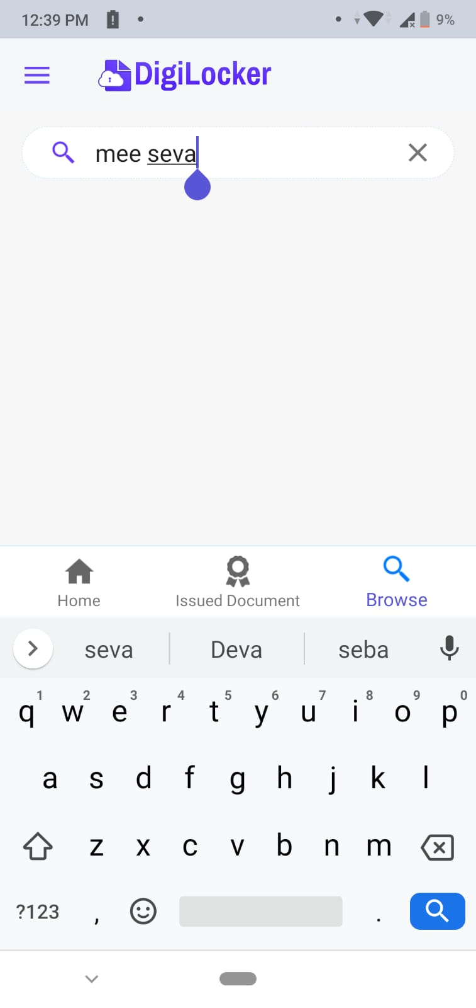
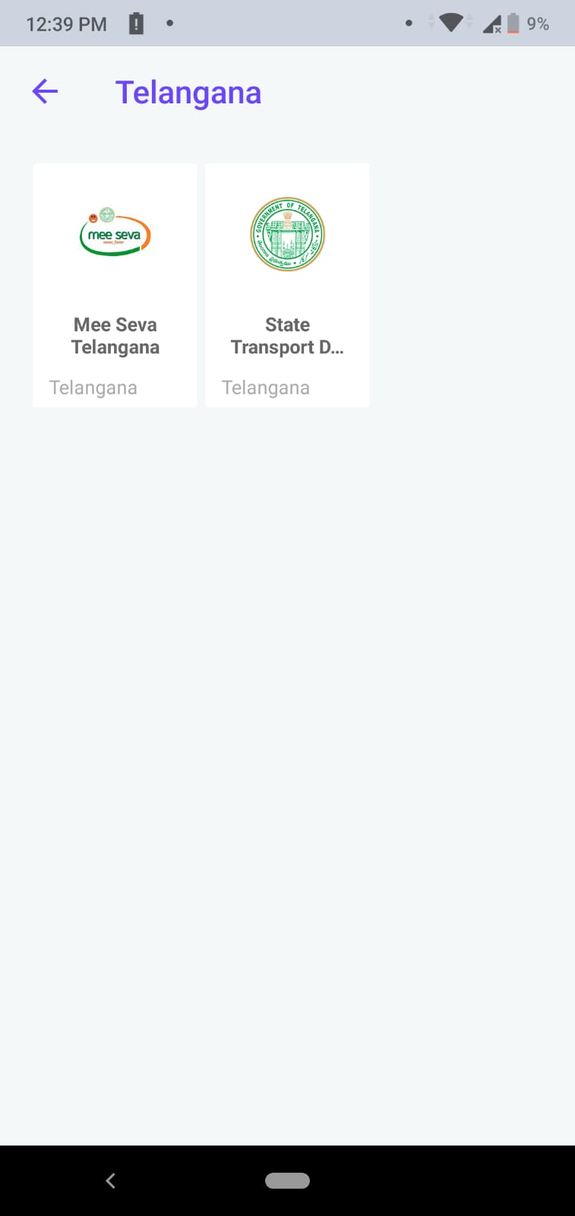
If I go in Telangana State sub cateogery MeeSeva
Telangana is available but while searching it is not.

Slide 7
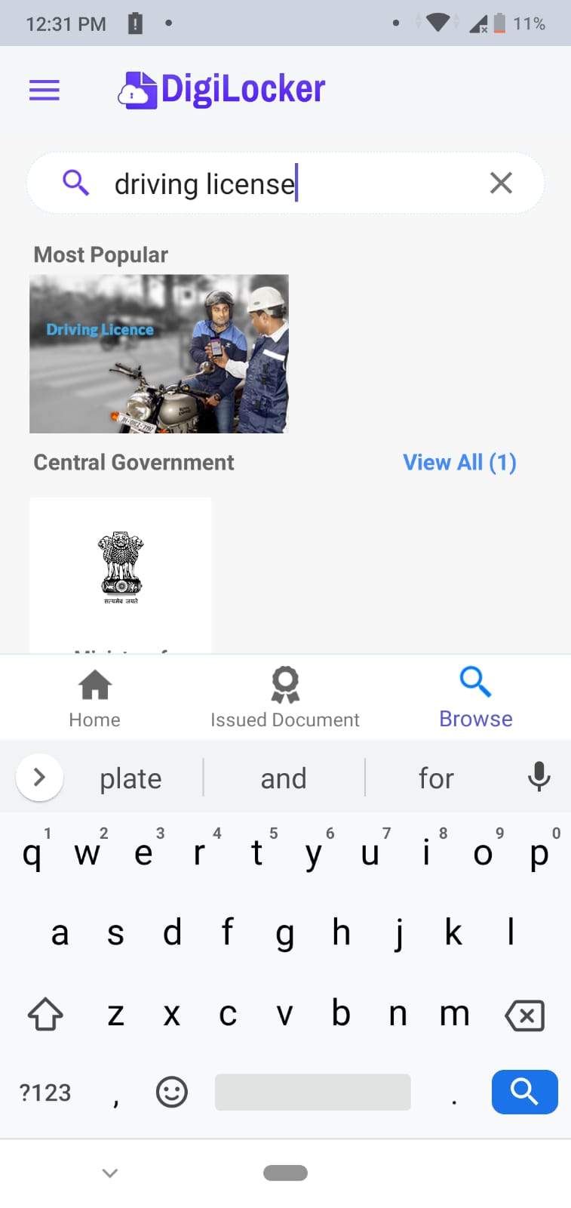
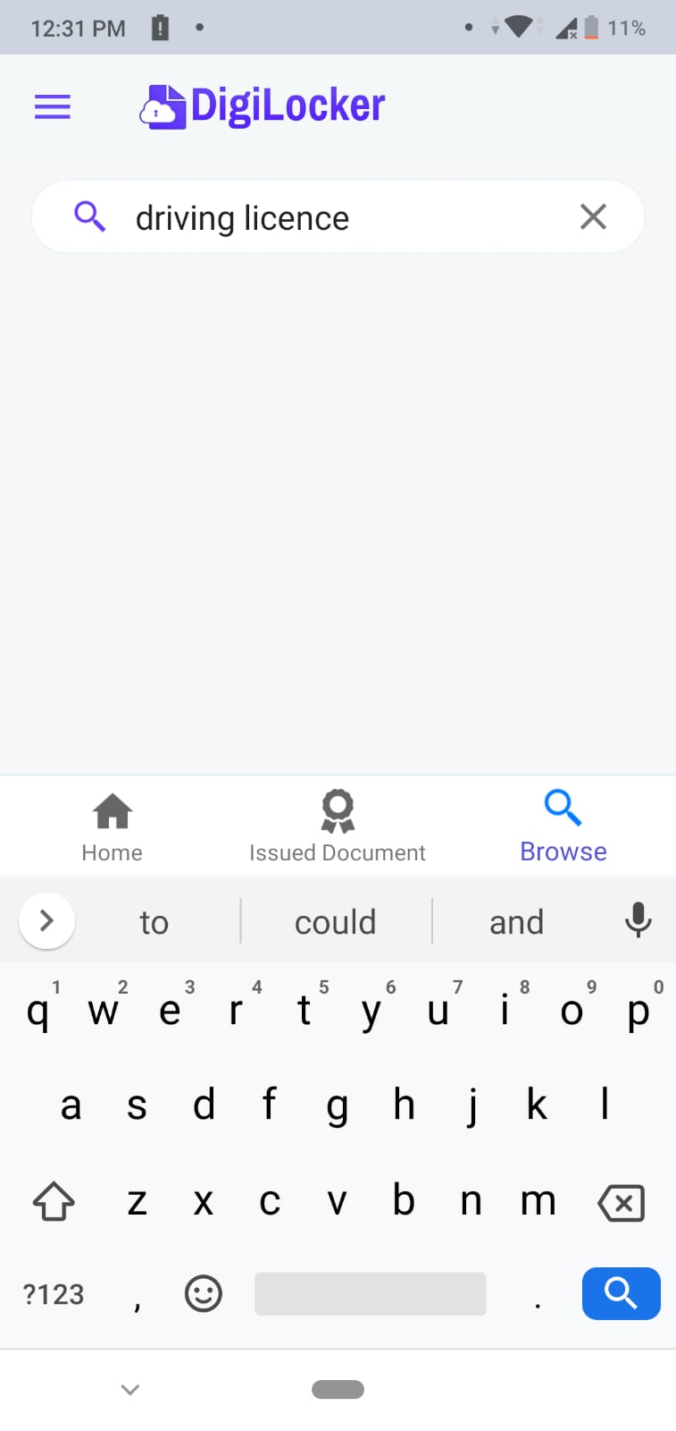
Driving licence is searched if write
incorrect spelling of licence “License”

Slide 8
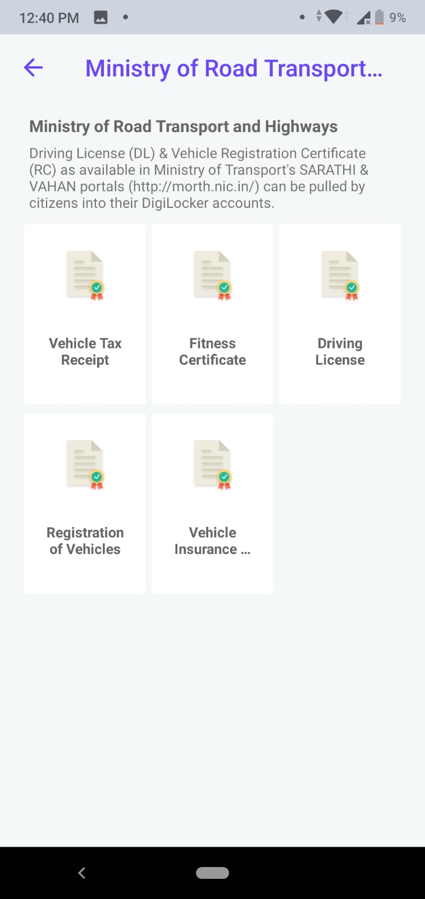
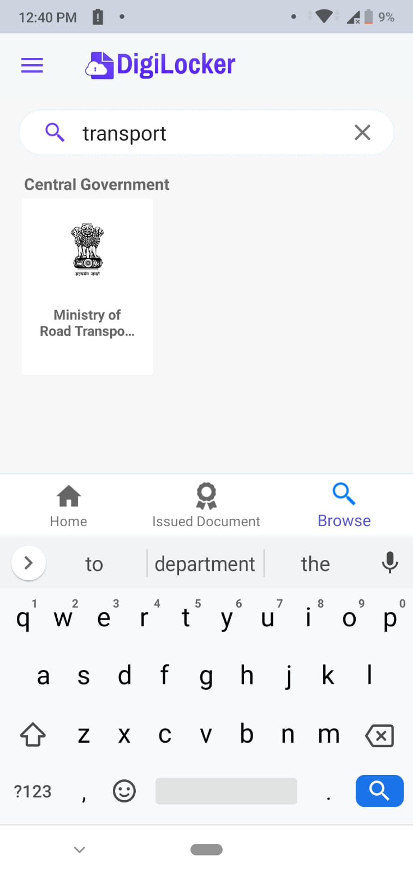
Searching Transport department it is unclear
which state department has been searched.

Slide 9
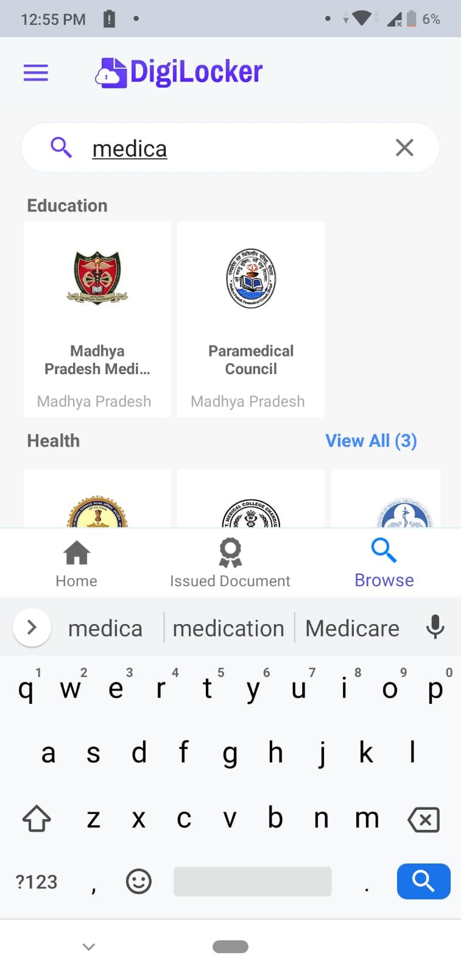
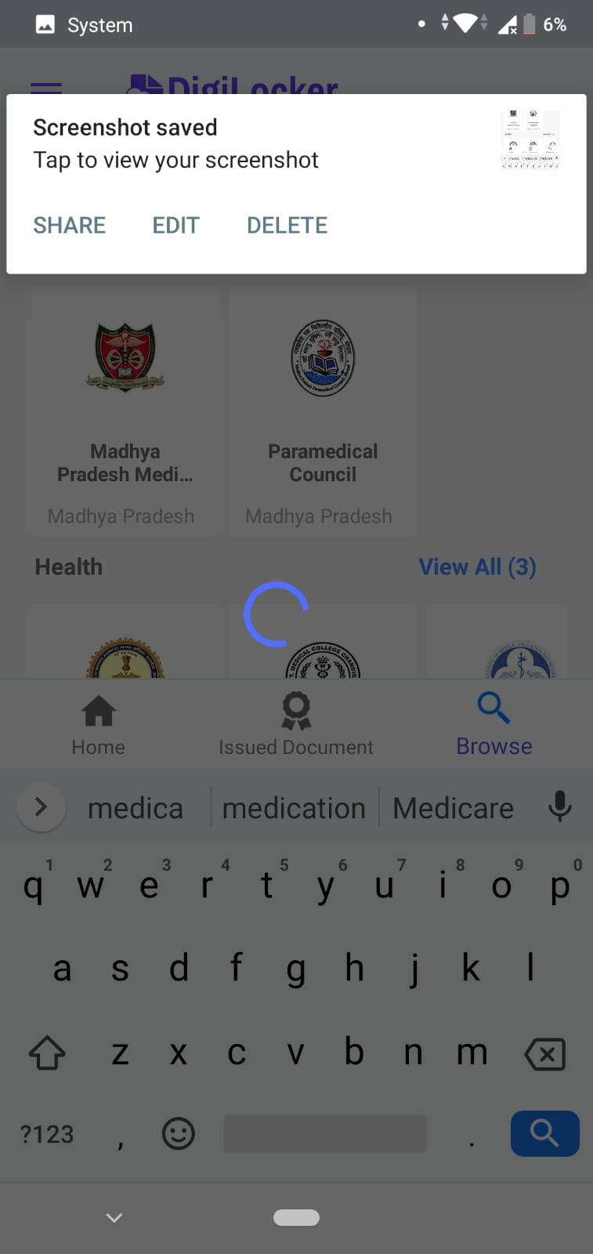
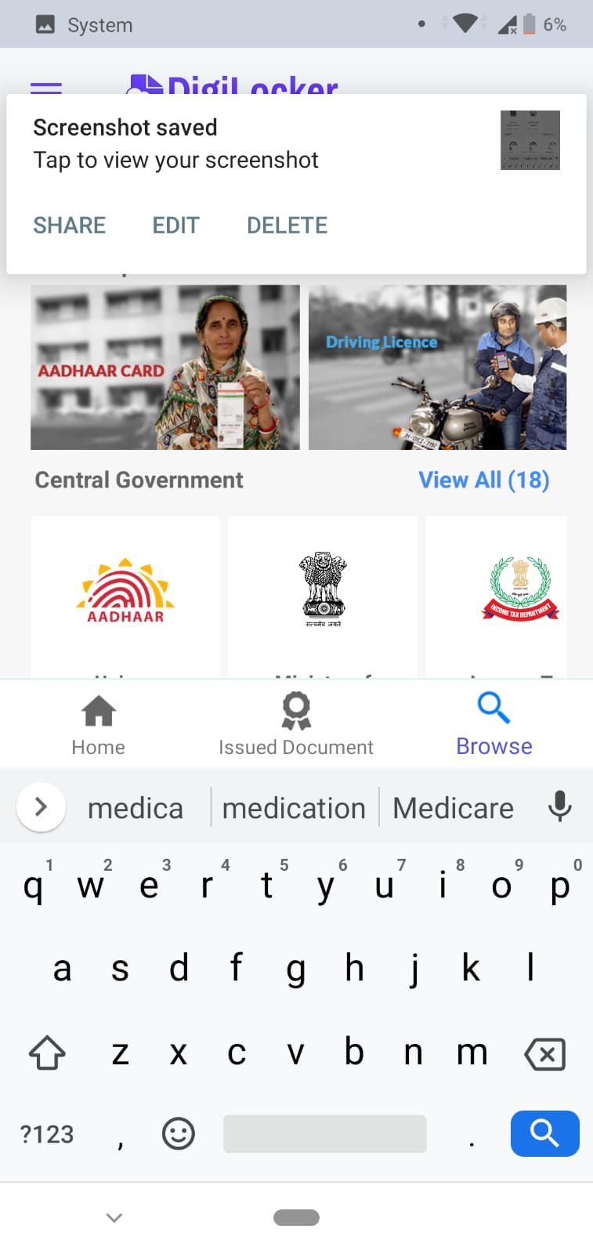
Sometimes While searching app refresh
itself or if I swipe down on searchThen it brings
back to dashboard
(automatically this happened 3 times
in 10 min of use)

