Slide 1
DIGILOCKER
TEST APP 29 BUGS
Version- TEST29.6.3.2
Updated on- 30/Nov/2020
By- Neeraj Pandey

Slide 2
Add Nominee in Profile Section

Slide 3
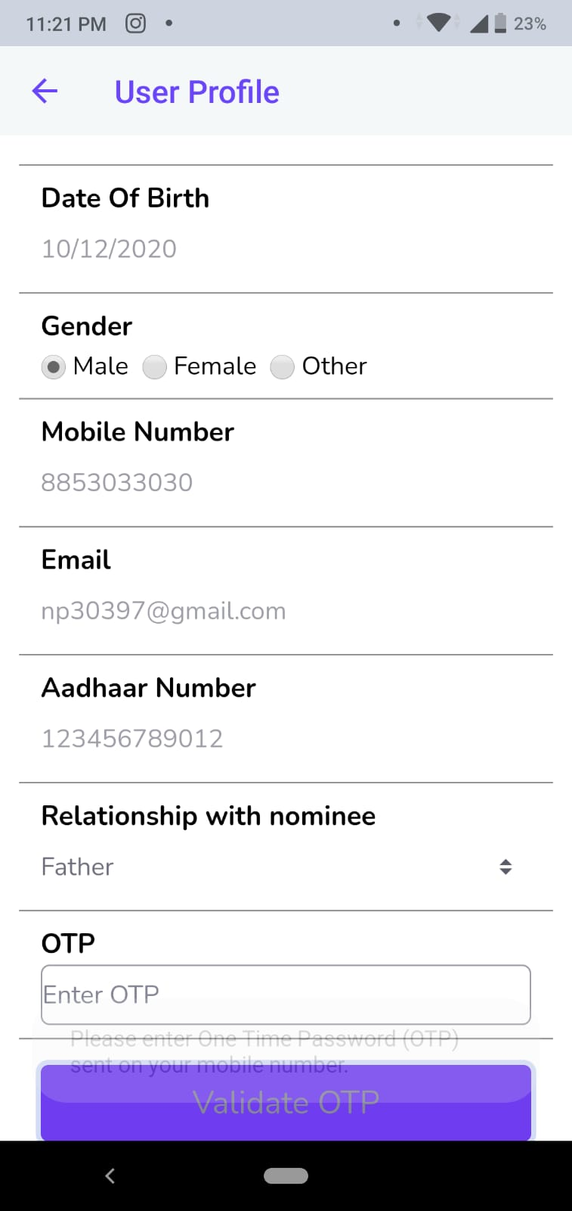
Given invalid Data in Nominee but then also sending OTP
Somewhere But not on the given number.
Data entered is in screenshot.

Slide 4
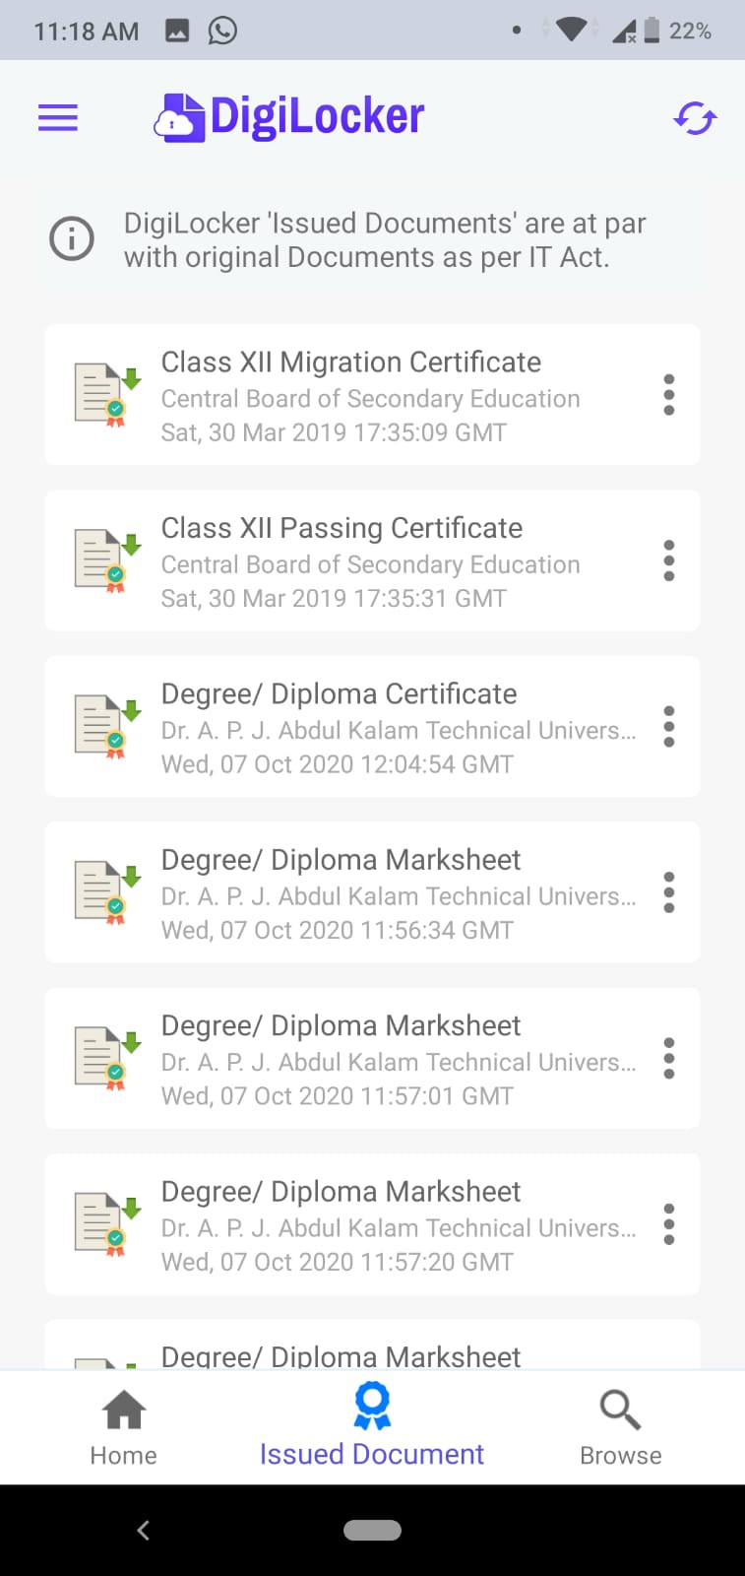
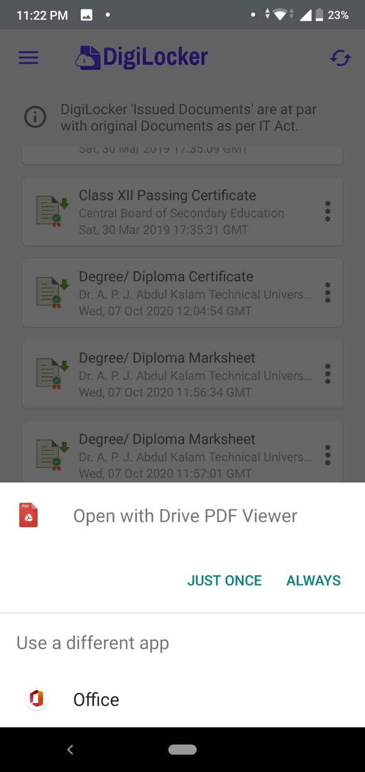
Unable to Fetch my Documents like
Degree/Diploma Marksheet.
Option shows to open via .pdf format
And when I click to open a white
Screen opens and then closes.

Slide 5
Search Functionality

Slide 6
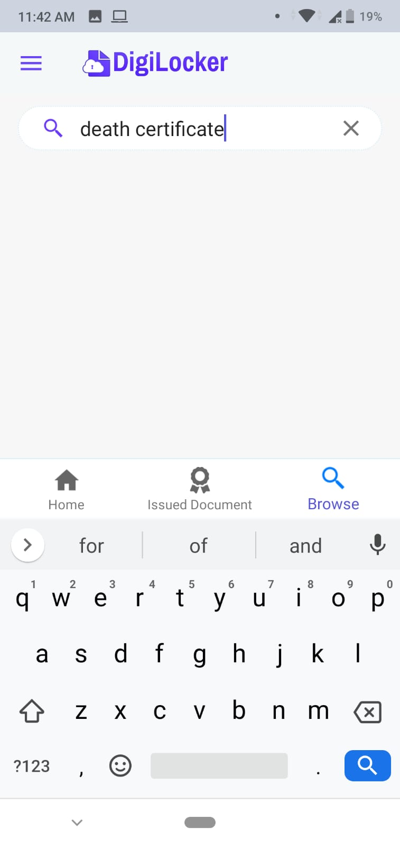
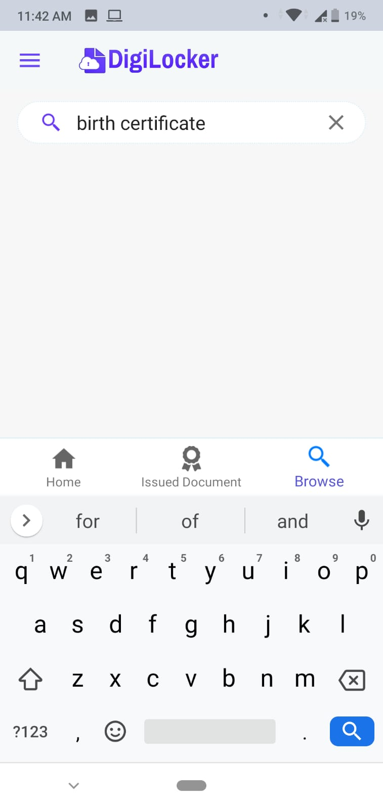
Some data is not visible while searching.

Slide 7
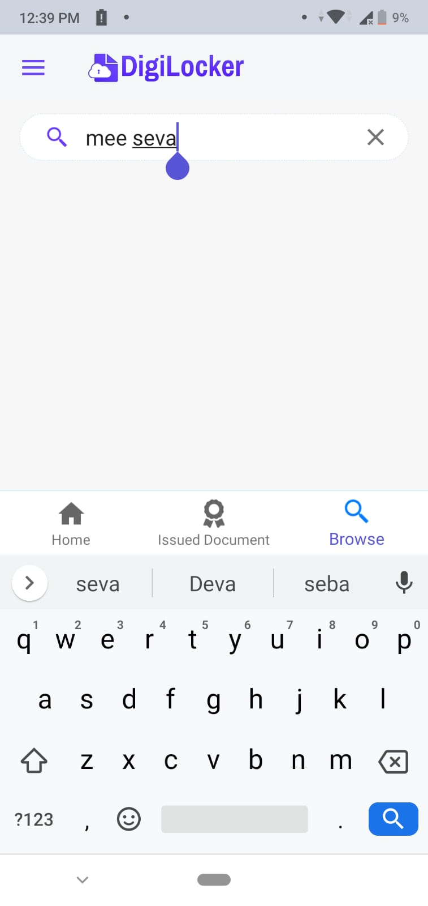
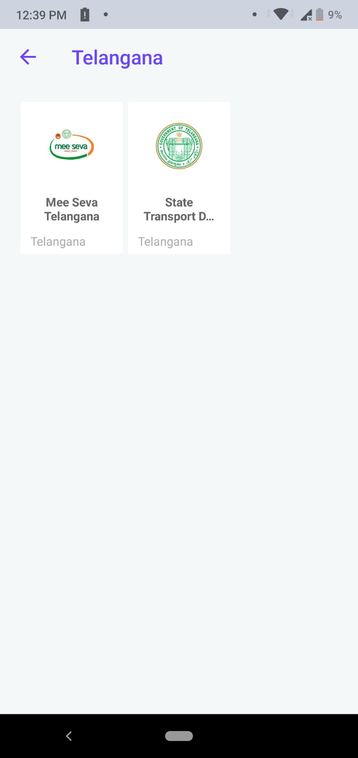
If I go in Telangana State sub category MeeSeva
Telangana is available but while searching it is not.

Slide 8
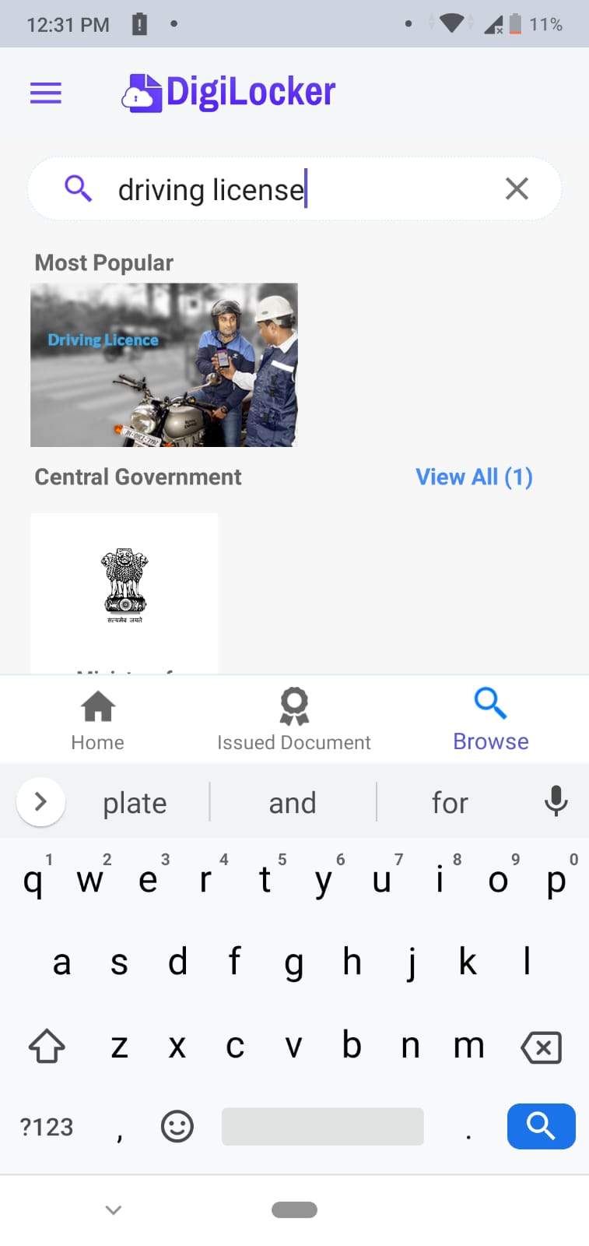
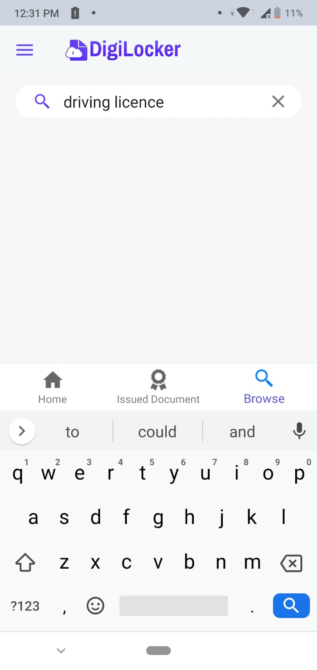
Driving licence is searched if write
incorrect spelling of licence “License”

Slide 9
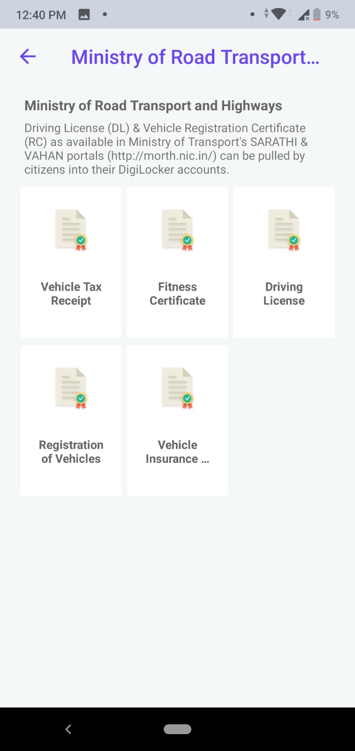
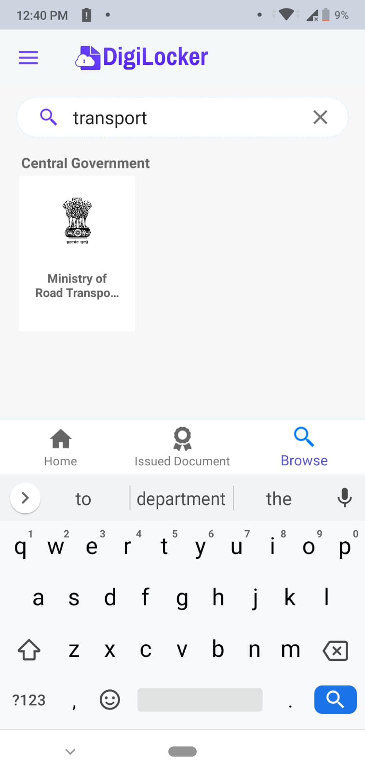
Searching Transport department it is unclear
which state department has been searched.

