Slide 1
DigiLocker Android App Testing
App Version : TEST36.6.3.2
Date of Testing : 11.12.2020
Tester : Pranav Ganesh Kadam (Intern)
Mobile Device : Motorola One Power
Android Version : 10
Display : 2246x1080p

Slide 2
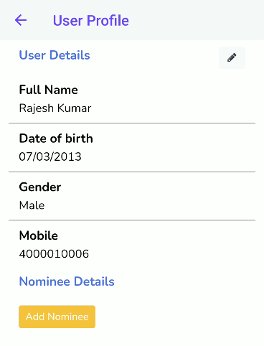
Add Nominee in User Profile

Slide 3
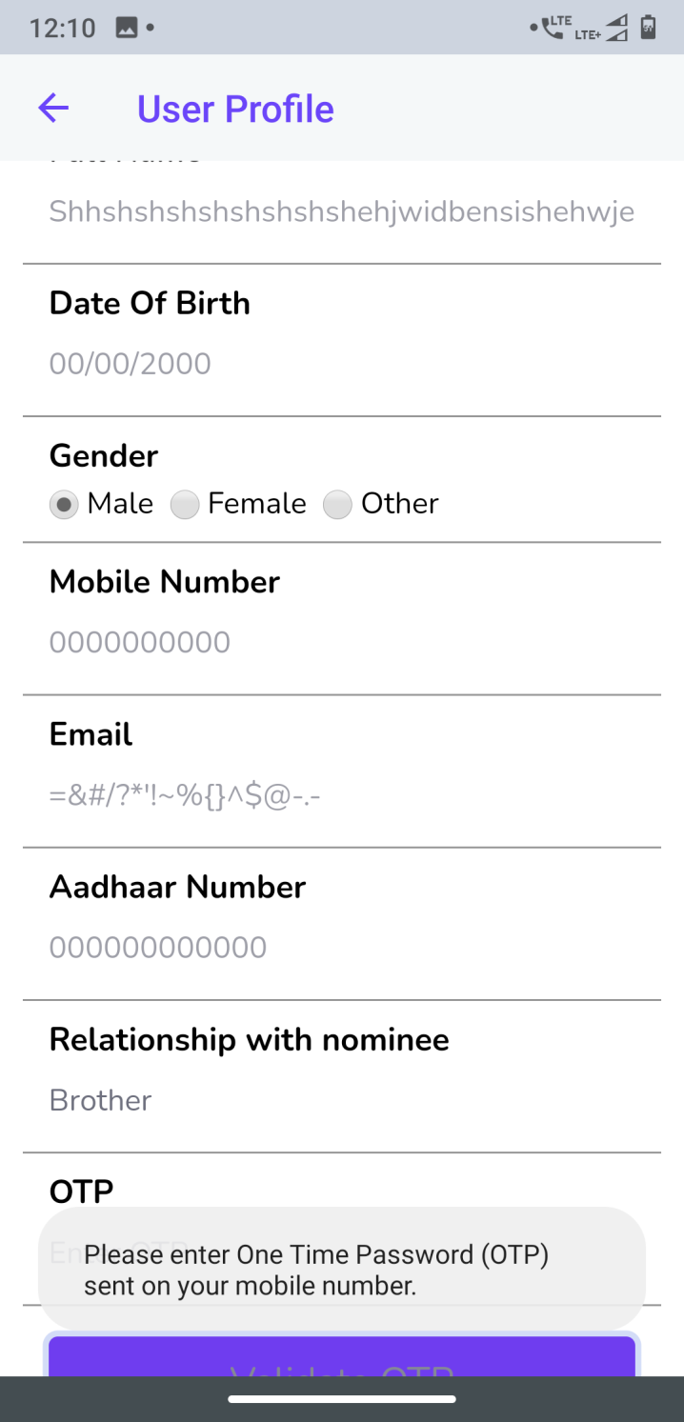
Invalid Inputs accepted without showing error.
Invalid Name with more than 20 characters accepted without giving any error.
Invalid Date of Birth accepted without giving any error.
Invalid Mobile number accepted and sent OTP to that mobile number. No error message is shown.
Invalid Email accepted with symbols which are not used in email. No error message is shown.
Invalid Aadhaar accepted. No error message is shown.

Slide 4
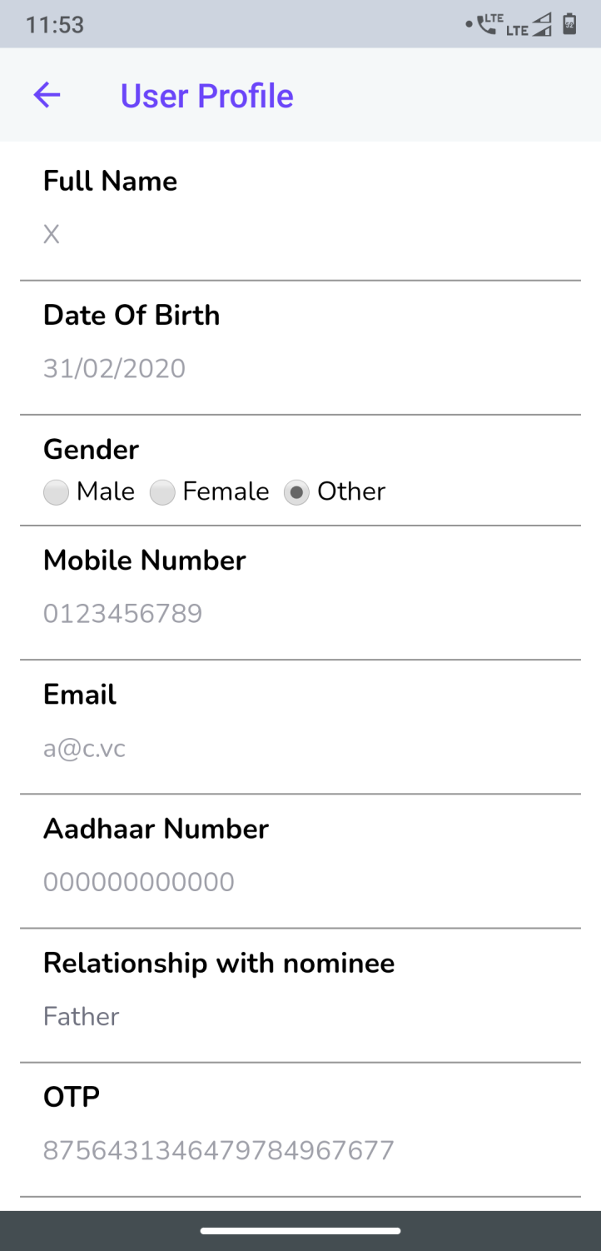
Invalid Inputs accepted without showing error.
Invalid Name with only 1 character is accepted without giving any error.
Invalid Date of Birth accepted without giving any error. Eg. 31 FEB 2020 – Year = Current Year & FEB can have maximum 29 days.
Invalid Mobile number accepted and sent OTP to that mobile number. No error message is shown.
Invalid Email accepted. No error message is shown.
Invalid OTP with more than 6 numbers are allowed to enter. And when clicked on validate OTP no error message is shown.

Slide 5
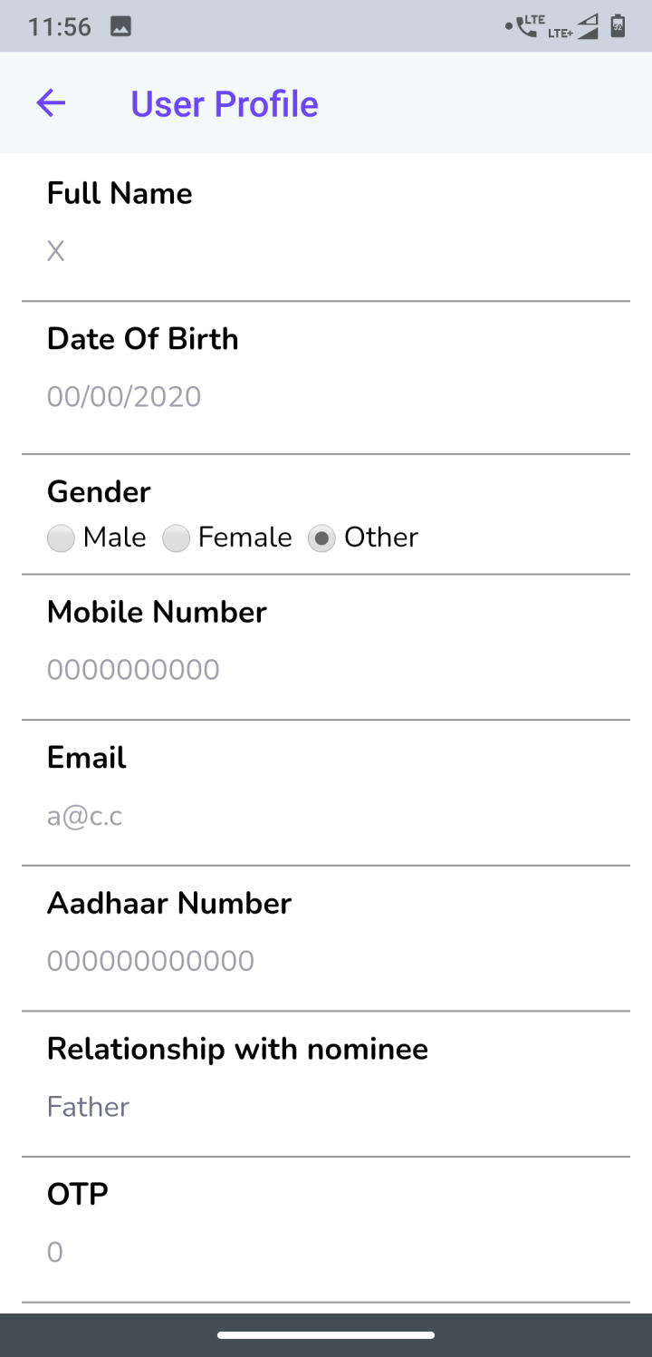
Invalid Inputs accepted without showing error.
Invalid Email accepted with numbers.
No error message is shown.
Invalid OTP with only 1 number is allowed to enter. And when clicked on validate OTP no error message is shown.

Slide 6
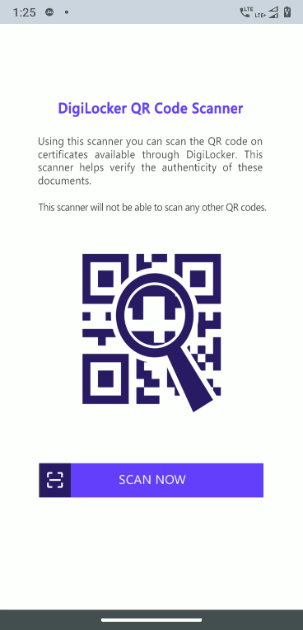
Scan QR Code – Back Button is not available.
Navigate Back Button is Missing.

Slide 7
Thank You

